Slide 1
Objectives of this data science project
Data science job applications are enhanced by inclusion of a data science project. This project should showcase a variety of data science skills through coding, including dataset manipulation, visualization, statistics, and machine learning. It is best if the context of these skills is applied towards a question of personal interest to the applicant.
My interest lies in understanding how education can be used as a driver of social change. Through data analysis, I can identify features predictive of dropouts and therefore identify possible interventions to prevent dropouts. Therefore, I chose a dataset on dropout rates in California public schools.

Slide 2
Understand the circumstances that contribute to dropout rates are complex.
Linear regression cannot capture the complexity.
What we need is a way to understand what features could contribute to a school’s dropout rate.

Slide 3
Analysis of student dropouts in California public schools
By Ben Lacar

Slide 4
Project description
This project is in three parts. Part One is understanding what sub-populations of California high school students are susceptible to dropping out. Part Two is evaluating school demographics and economic factors that correlate with high dropout rate. Part Three is identifying “outlier” schools: educational communities that are demographically at-risk, but show a low dropout rate. My hope is that identifying outlier schools could lead to understanding the support mechanisms in these exceptional schools.

Slide 5
Data overview

Slide 6
Dataset sources
School information (CA Department of Education)
School name
Zip code
School type (e.g. public high school, K-12, alternative school)
Enrollment and dropout data for each school by gender, ethnicity for 2015-16 (CA Department of Education)
Median household income by school zip code for 2015 (factfinder.census.gov)

Slide 7
Data science methods and packages using Python
Web scraping
Urllib
Beautiful soup
Data frame cleaning and manipulation
Pandas
Visualization
Matplotlib
Seaborn
Statistics and machine learning (PCA)
Scipy
Scikit-learn

Slide 8
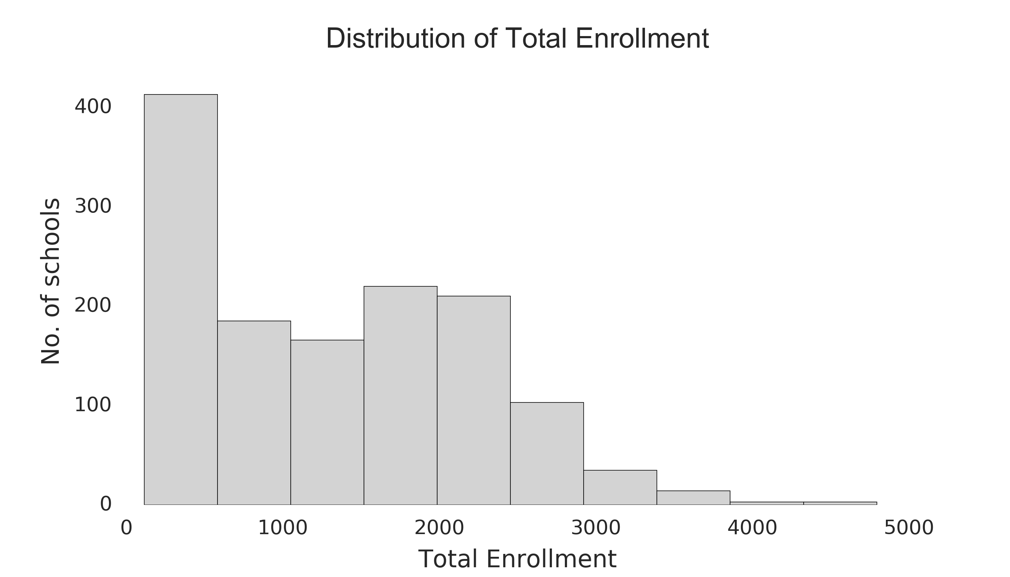
Characteristics of school population studied
Schools with high school population, defined as at least 25 students each in grades 9-12 (n=1352)

Slide 9
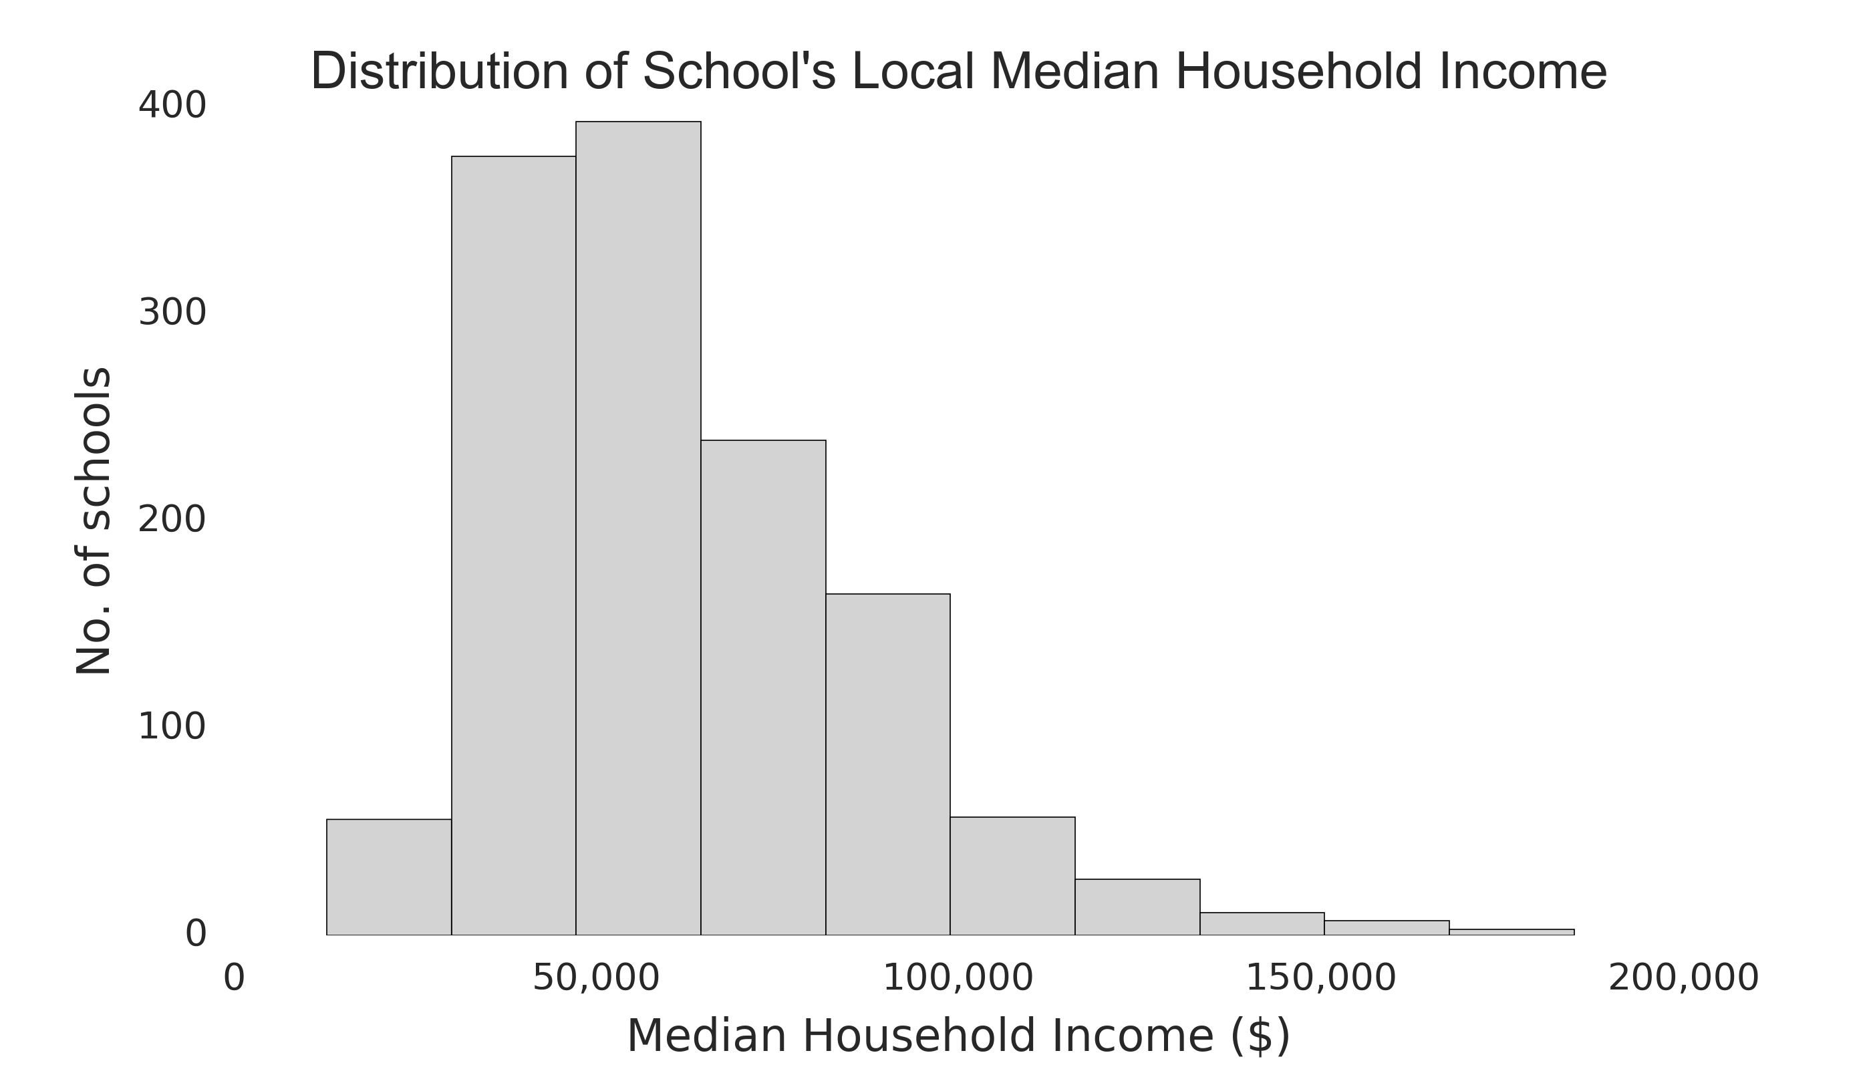
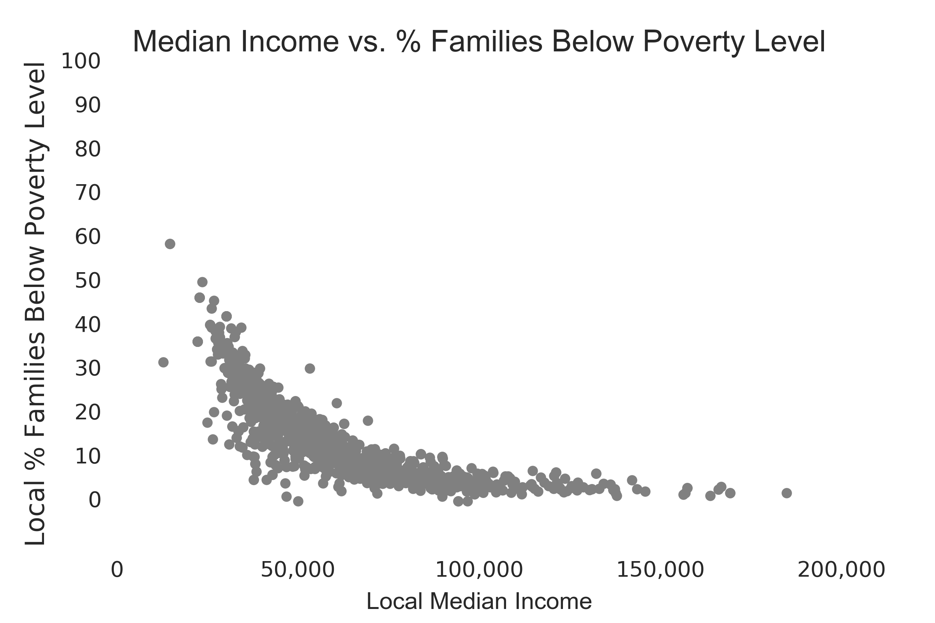
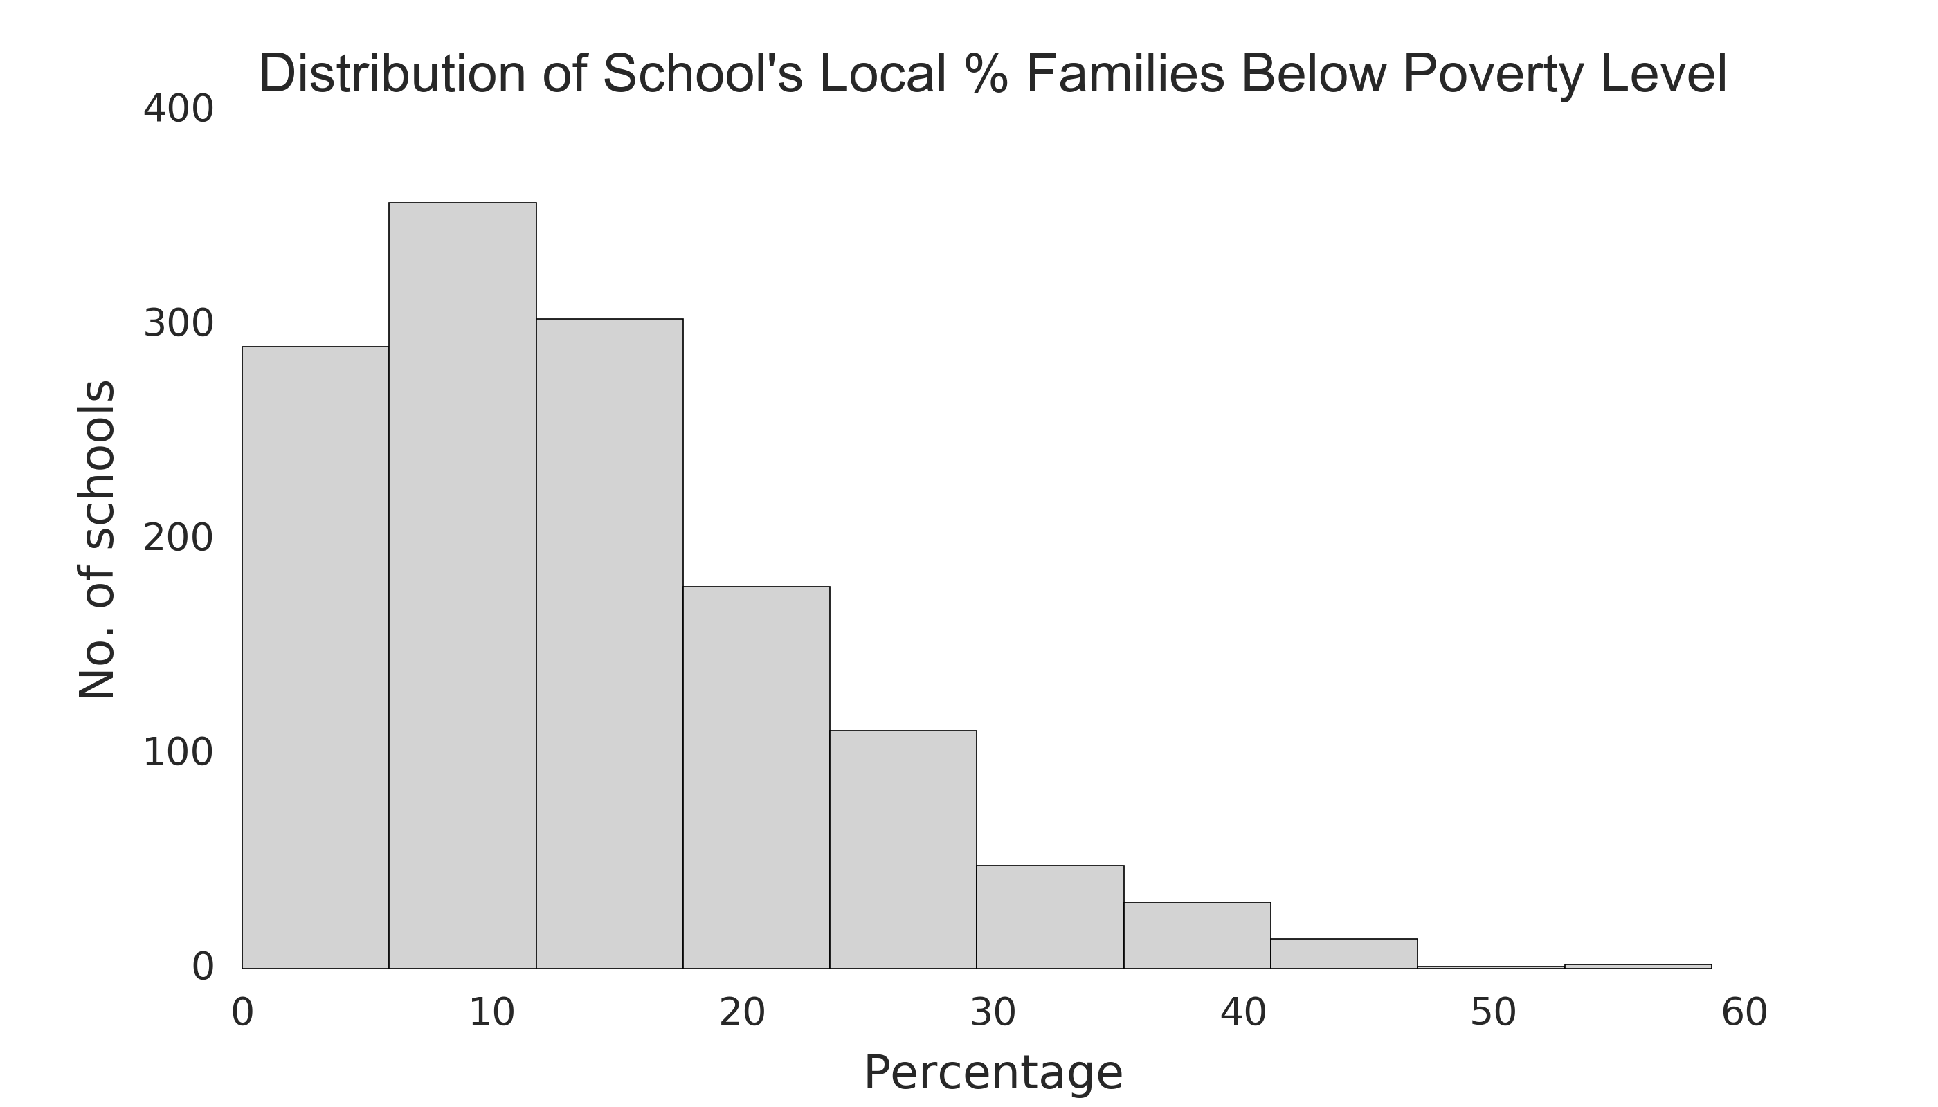
Economic characteristics of schools
Important note: This economic data is taken as an approximation for the school. It is for the school’s zip code and not for the families of students attending that school.
Some missing data for school’s local median income (18) and school’s local percentage of families with income below poverty level (17)

Slide 10
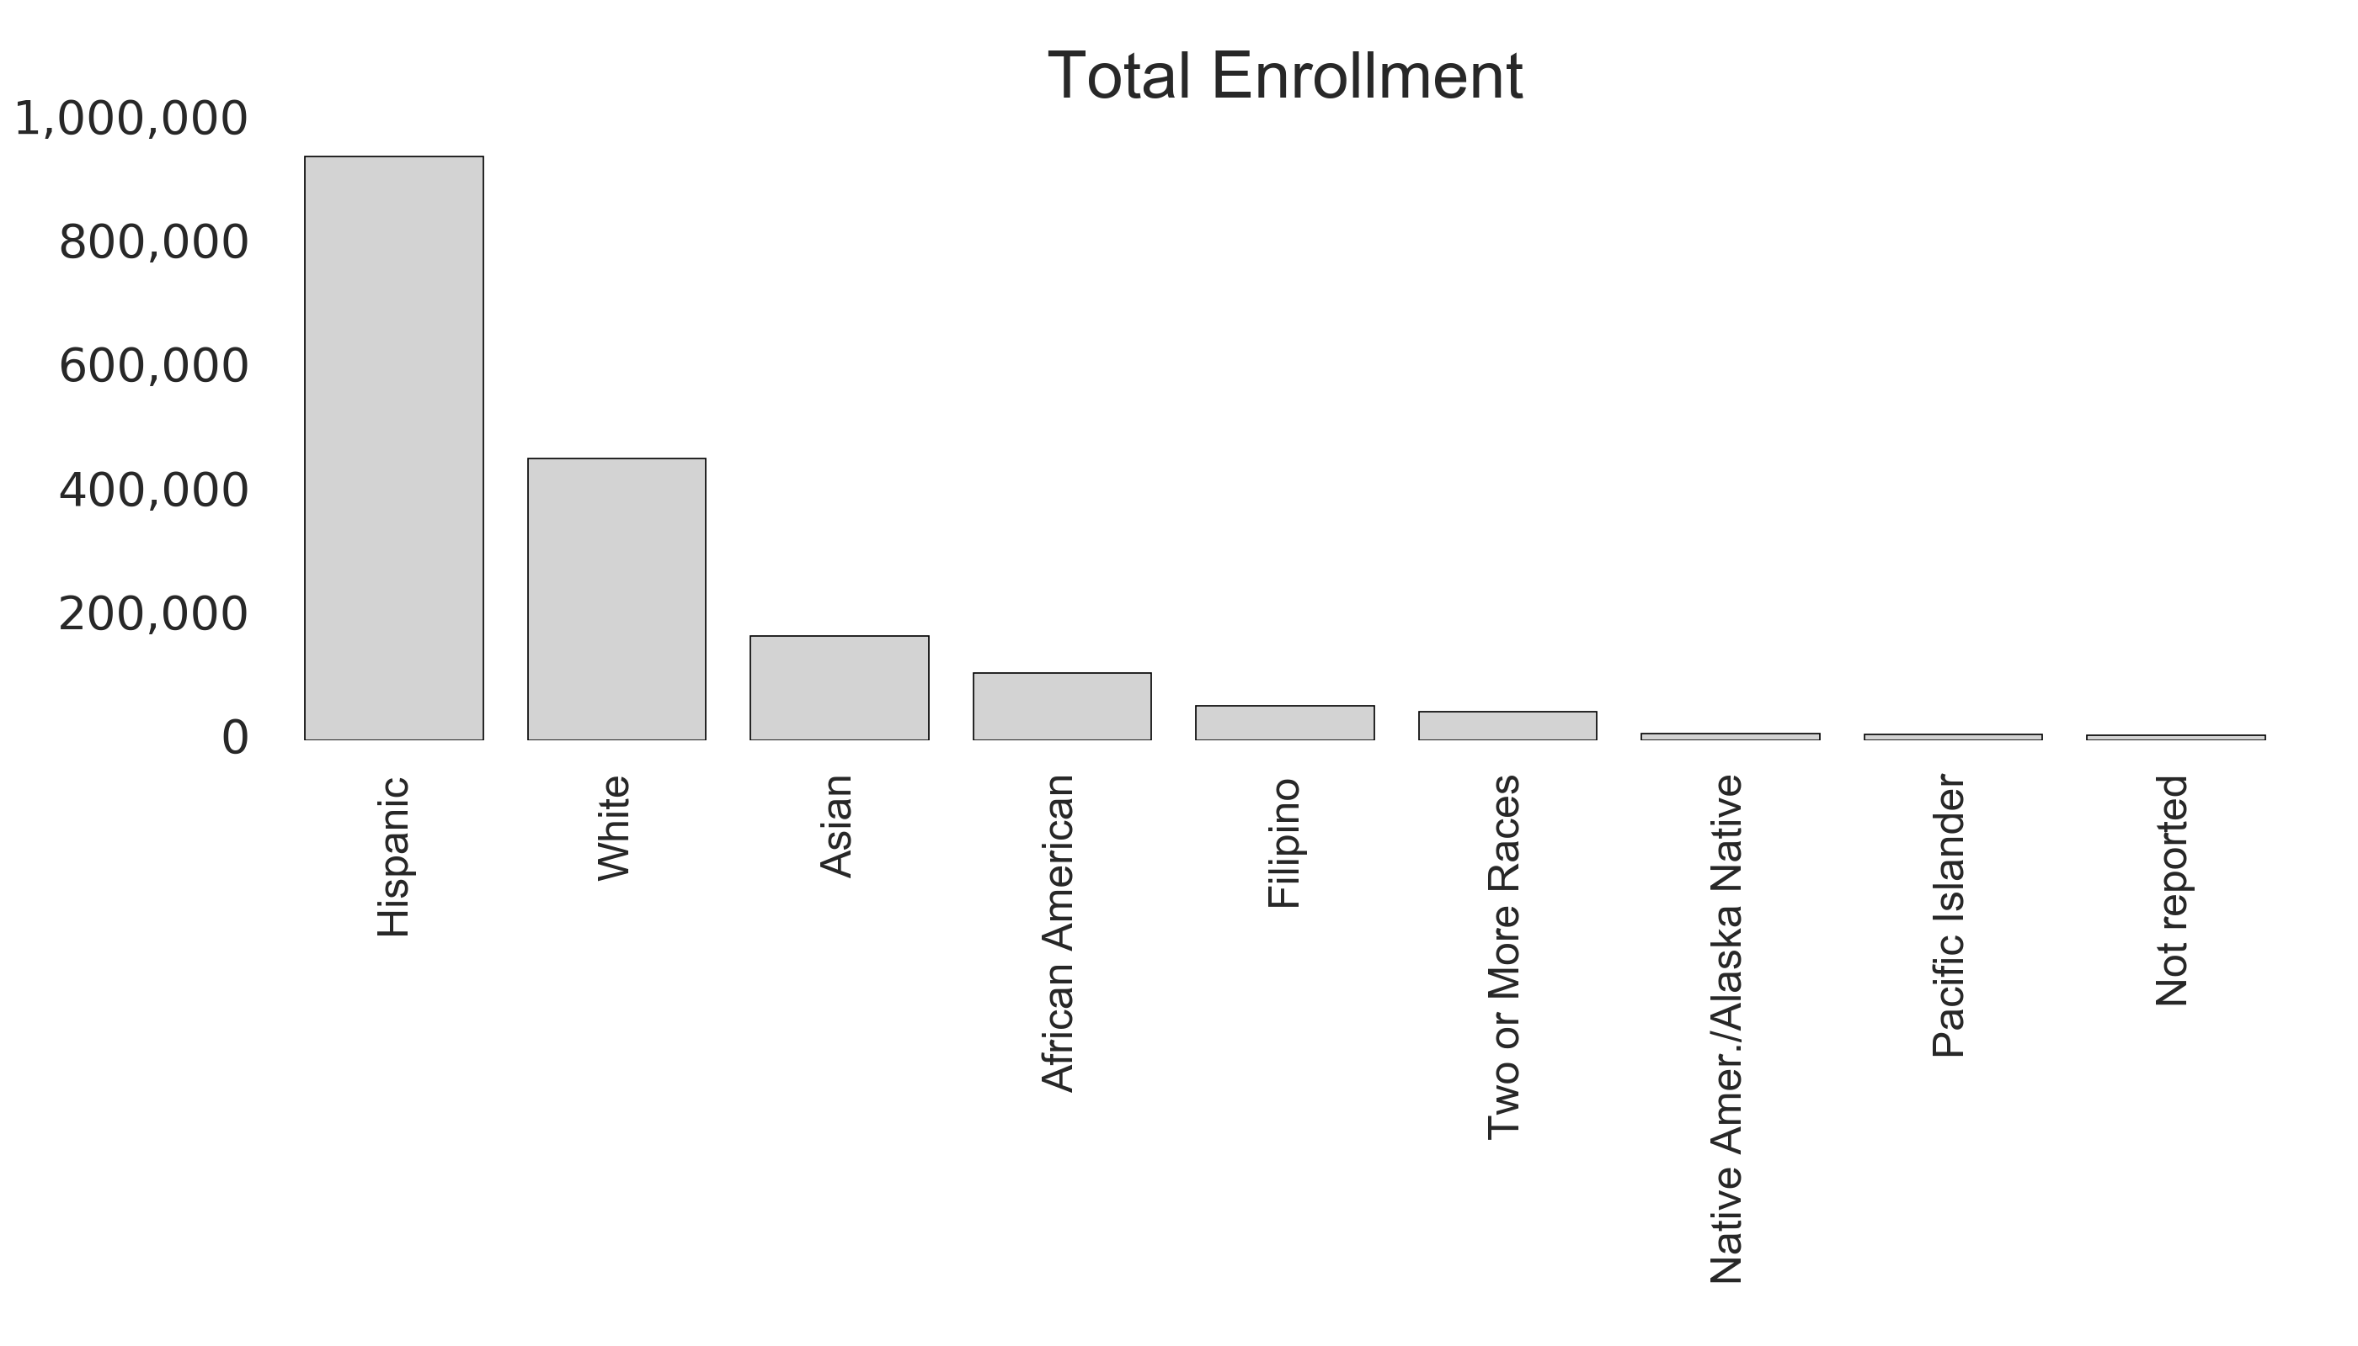
Demographics of students
Females: 886,534
Males: 917, 914
Total: 1,804,448

Slide 11
Part One: Student sub-populations susceptible to dropping out

Slide 12
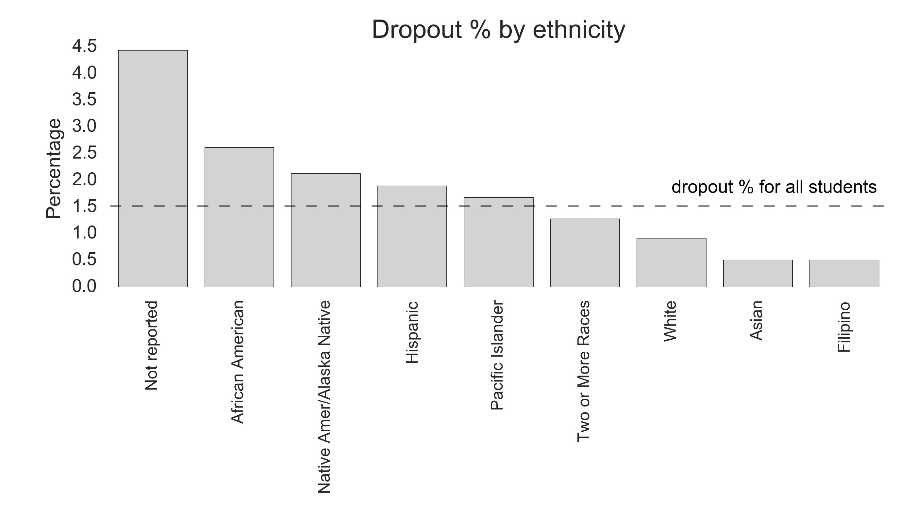
Student dropout percentage by ethnicity

Slide 13
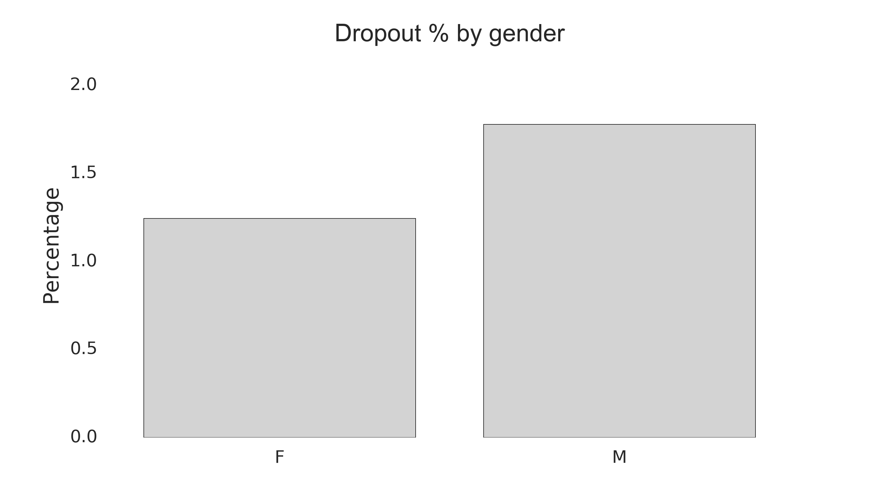
Student dropout percentage by gender

Slide 14
Summary of Part One
Statewide, 1.5% of the 1.8 million students dropped out from CA high schools in 2015-16.
African-Americans, Native Americans, Hispanics, and Pacific Islanders dropped out at a rate higher than the rate for all students.
Males are 1.4 times more likely to dropout than females.

Slide 15
Part Two: Demographics of schools with high dropout rates

Slide 16
Key question
What are the demographics of schools that show higher-than-average dropout rates?

Slide 17
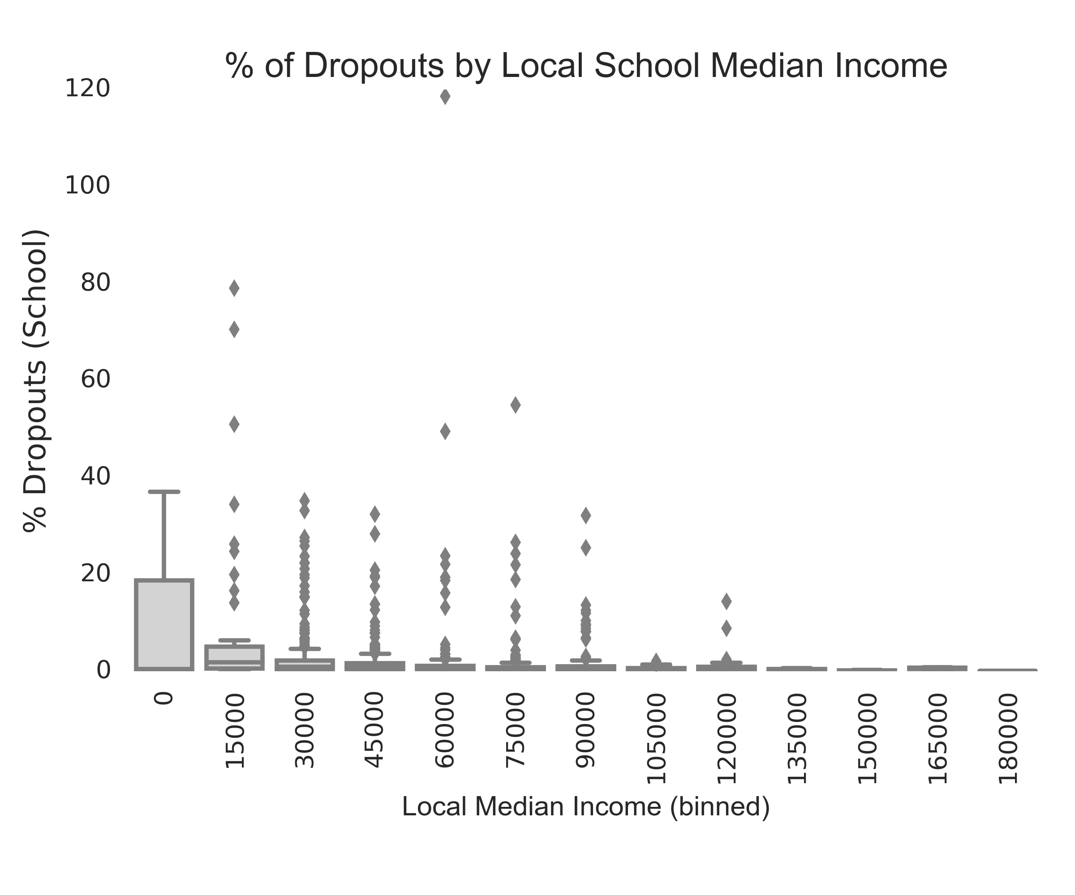
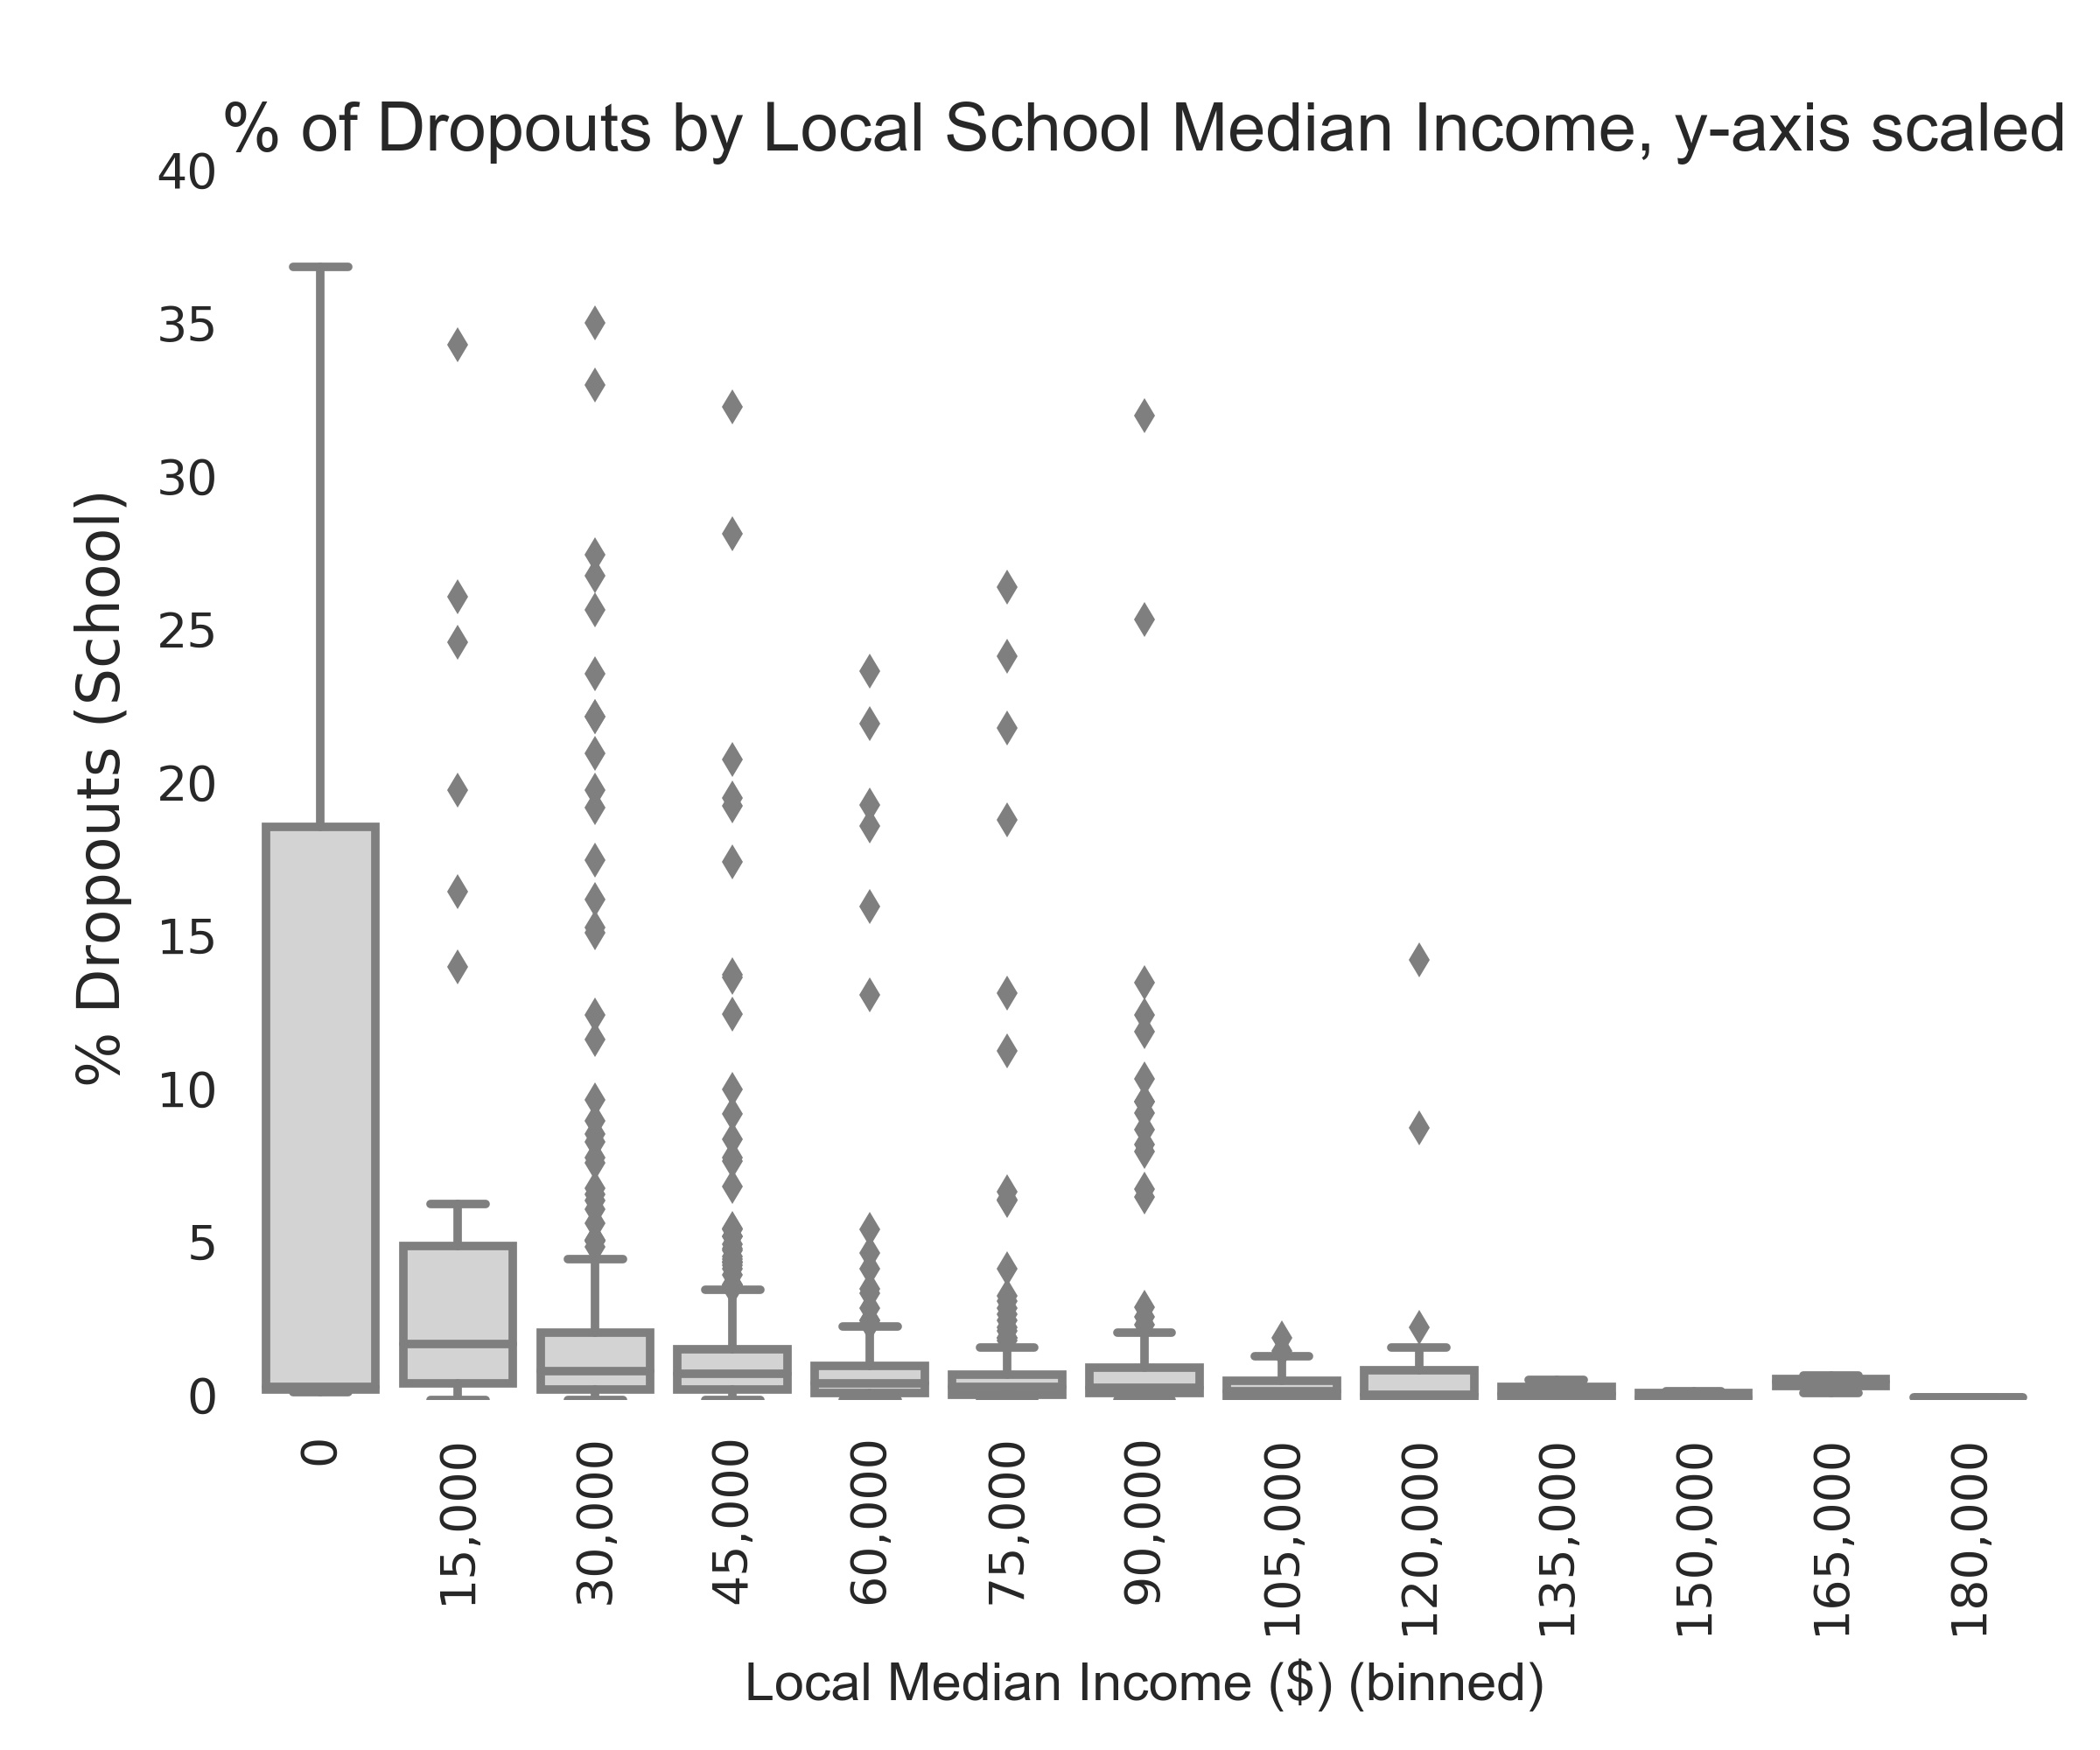
School dropout percentage by local median income
y-axis scaled

Slide 18
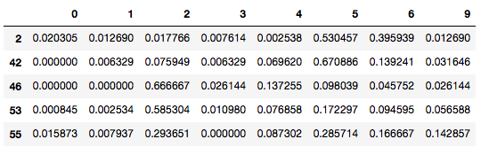
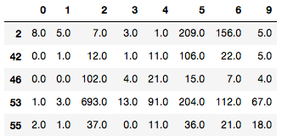
Creating a standardized demographic profile for each school
Schools vary in total enrollment numbers and local median income.
For capturing the ethnic profile of a school, demographic profiles were turned into proportions.
Ethnicities by enrollment numbers
Ethnicities by proportions
Rows are different schools, columns are different ethnicities.

Slide 19
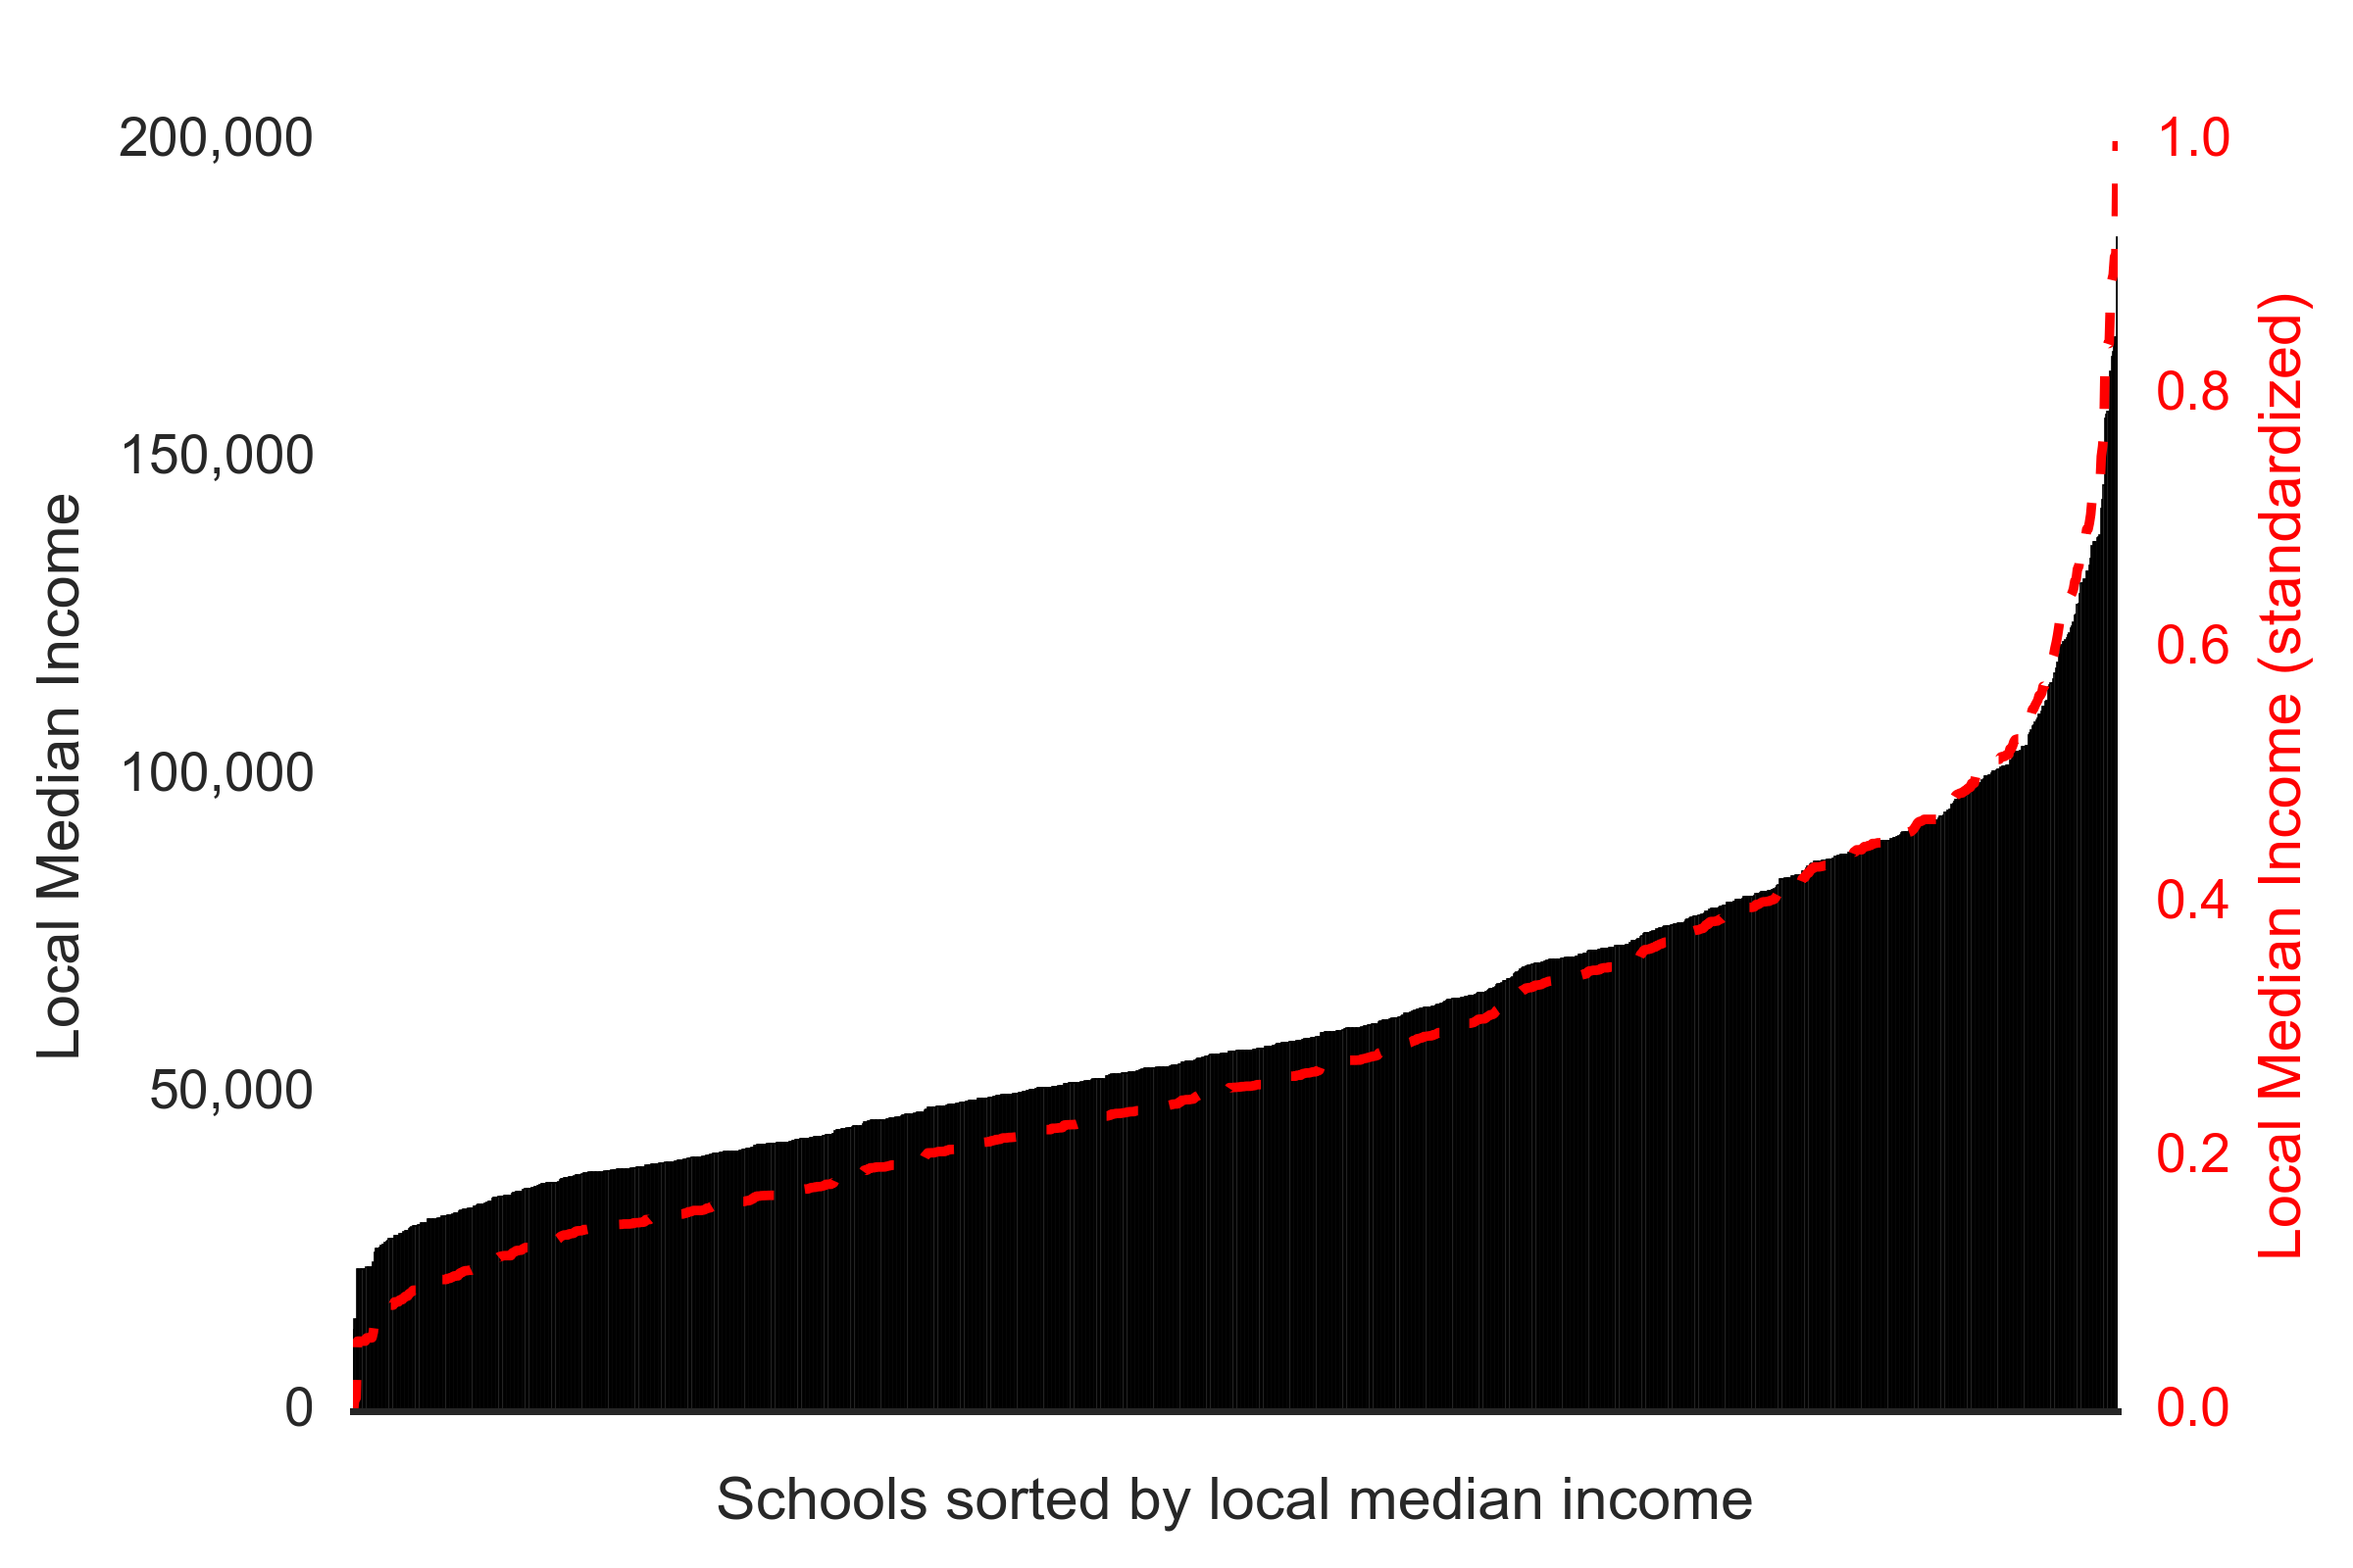
Median incomes for each school were min-max normalized
To put local median income on the same scale as the ethnic proportionality values, they were min-max normalized across the range in the study ($12,813 to $184,871 transformed to 0 to 1 scale).
While income inequality is not the focus of this study, it is apparent in the normalization. For example, a school with a local median income of $100,000 has a min-max normalization score of only 0.5.

Slide 20
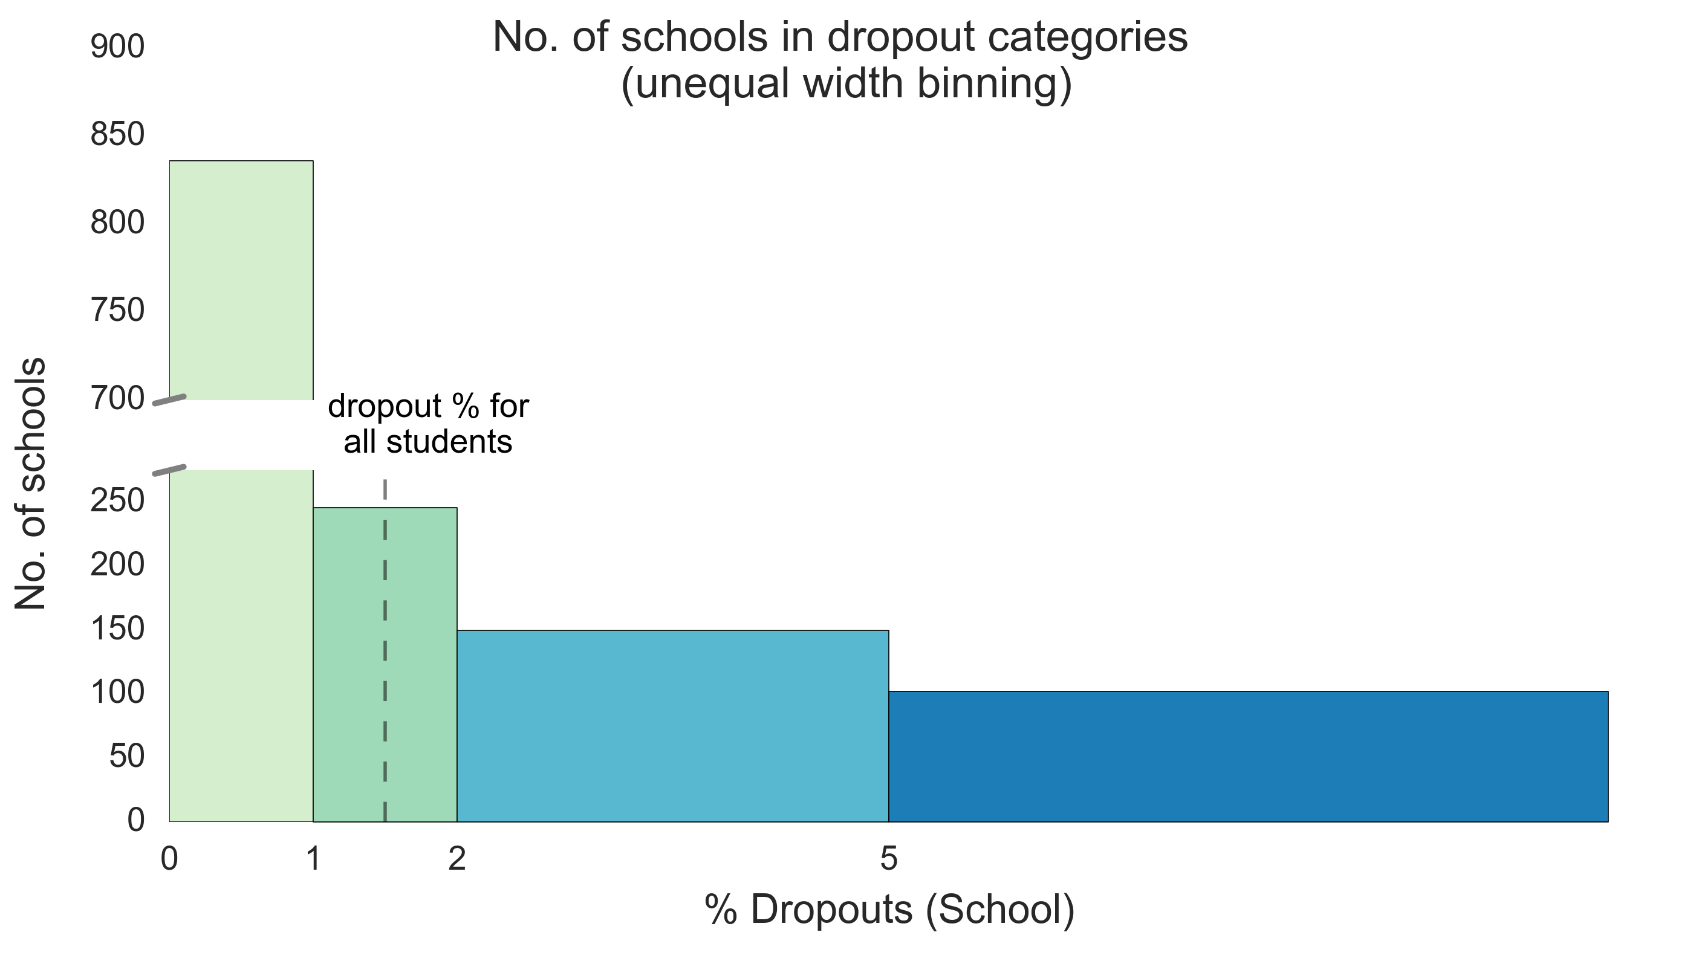
Schools were categorized based on dropout percentage
dropout category | dropout % values | No. of schools
0 | 0-1% | 836
1 | 1-2% | 246
2 | 2-5% | 150
3 | >5% | 102

Slide 21
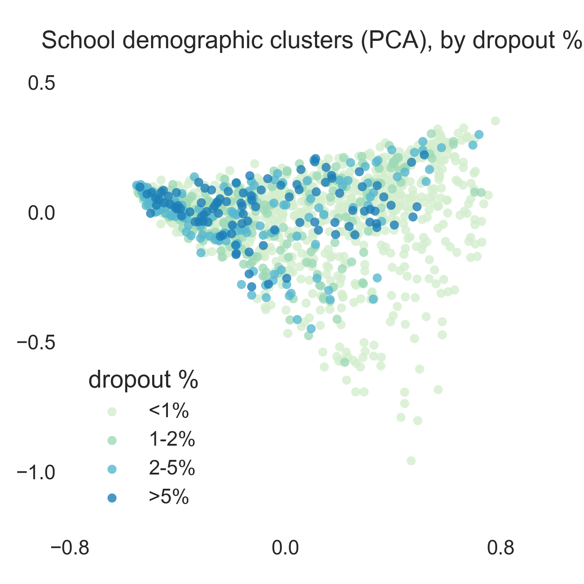
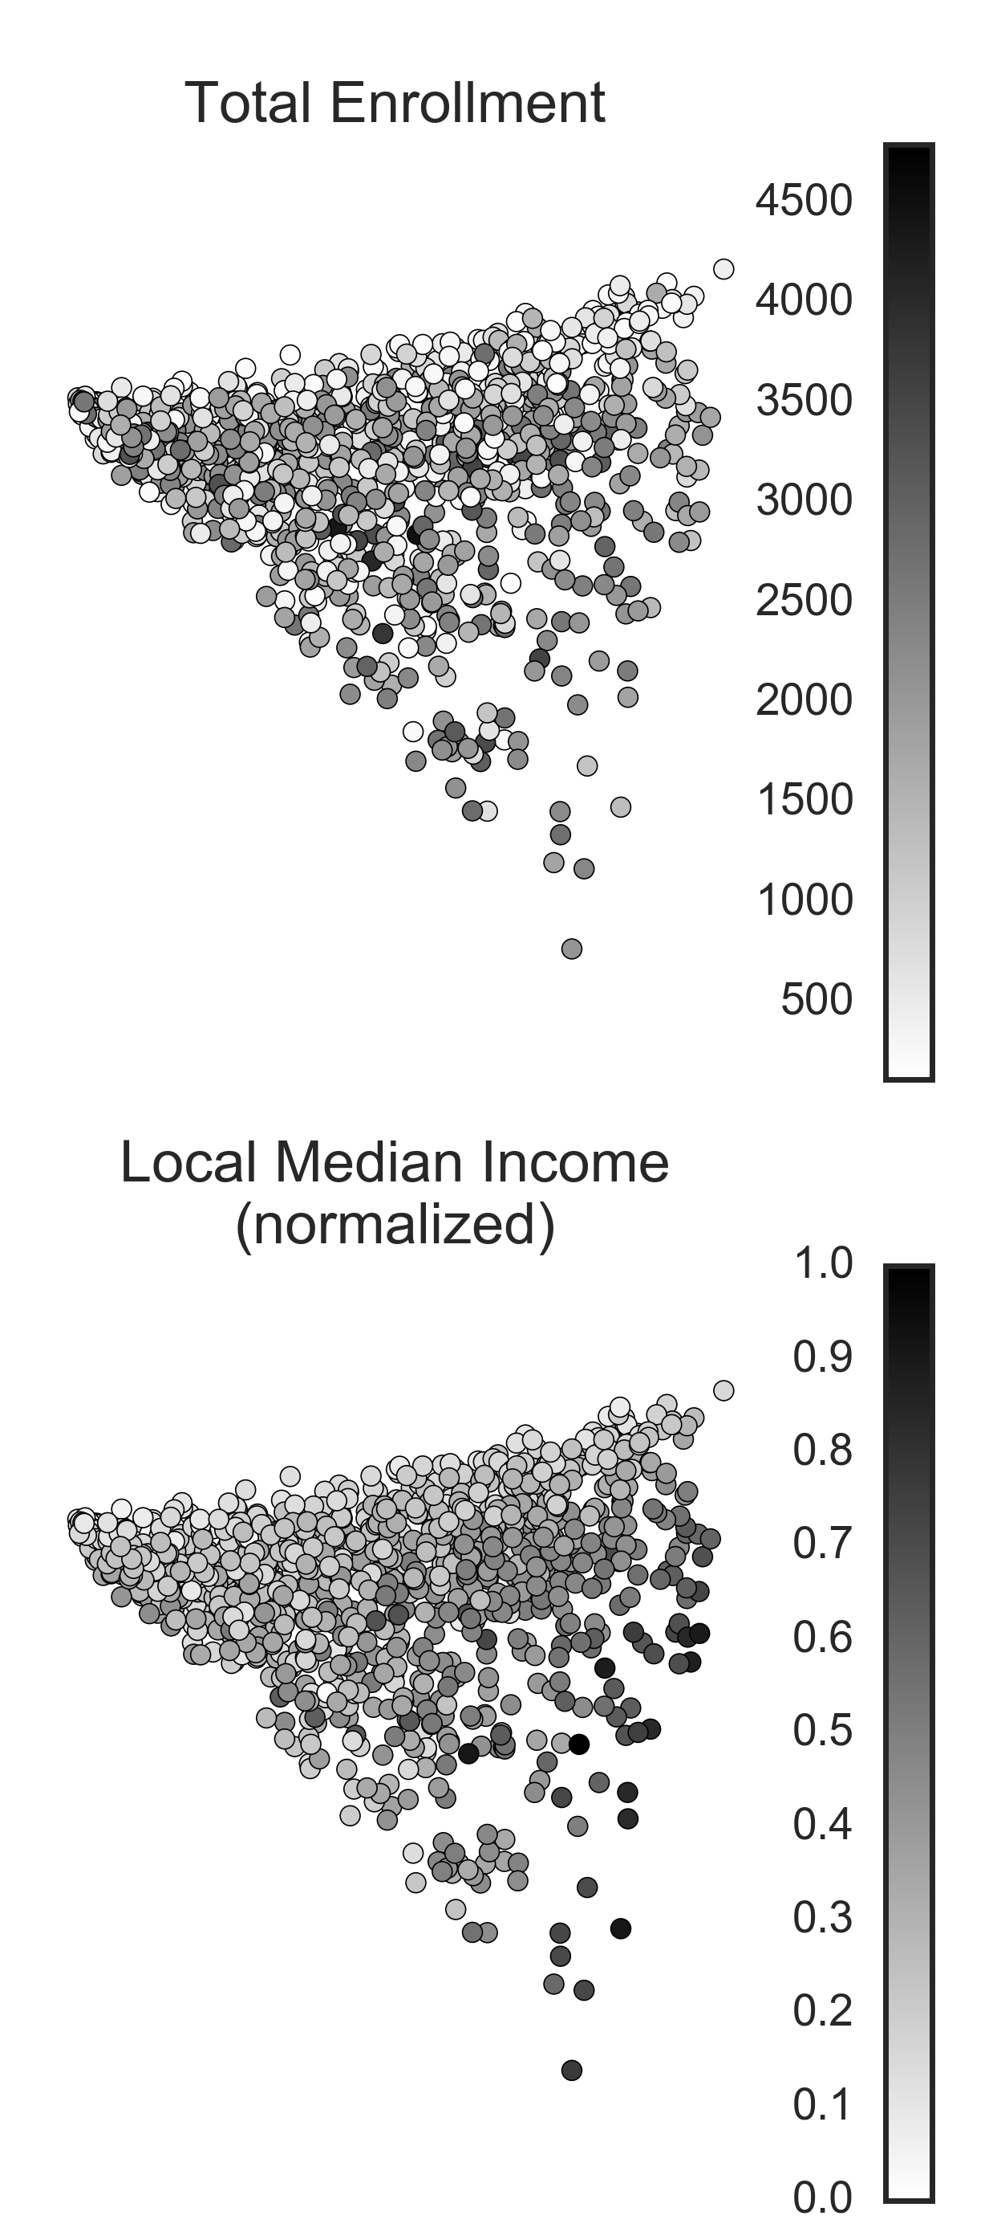
School demographic clusters
In this principal component analysis (PCA) representation, each point is a school. The proximity of one point relative to another is closely tied to how similar demographically (ethnic proportion and median income). The color-coding of each point is related to the category indicated.

Slide 22
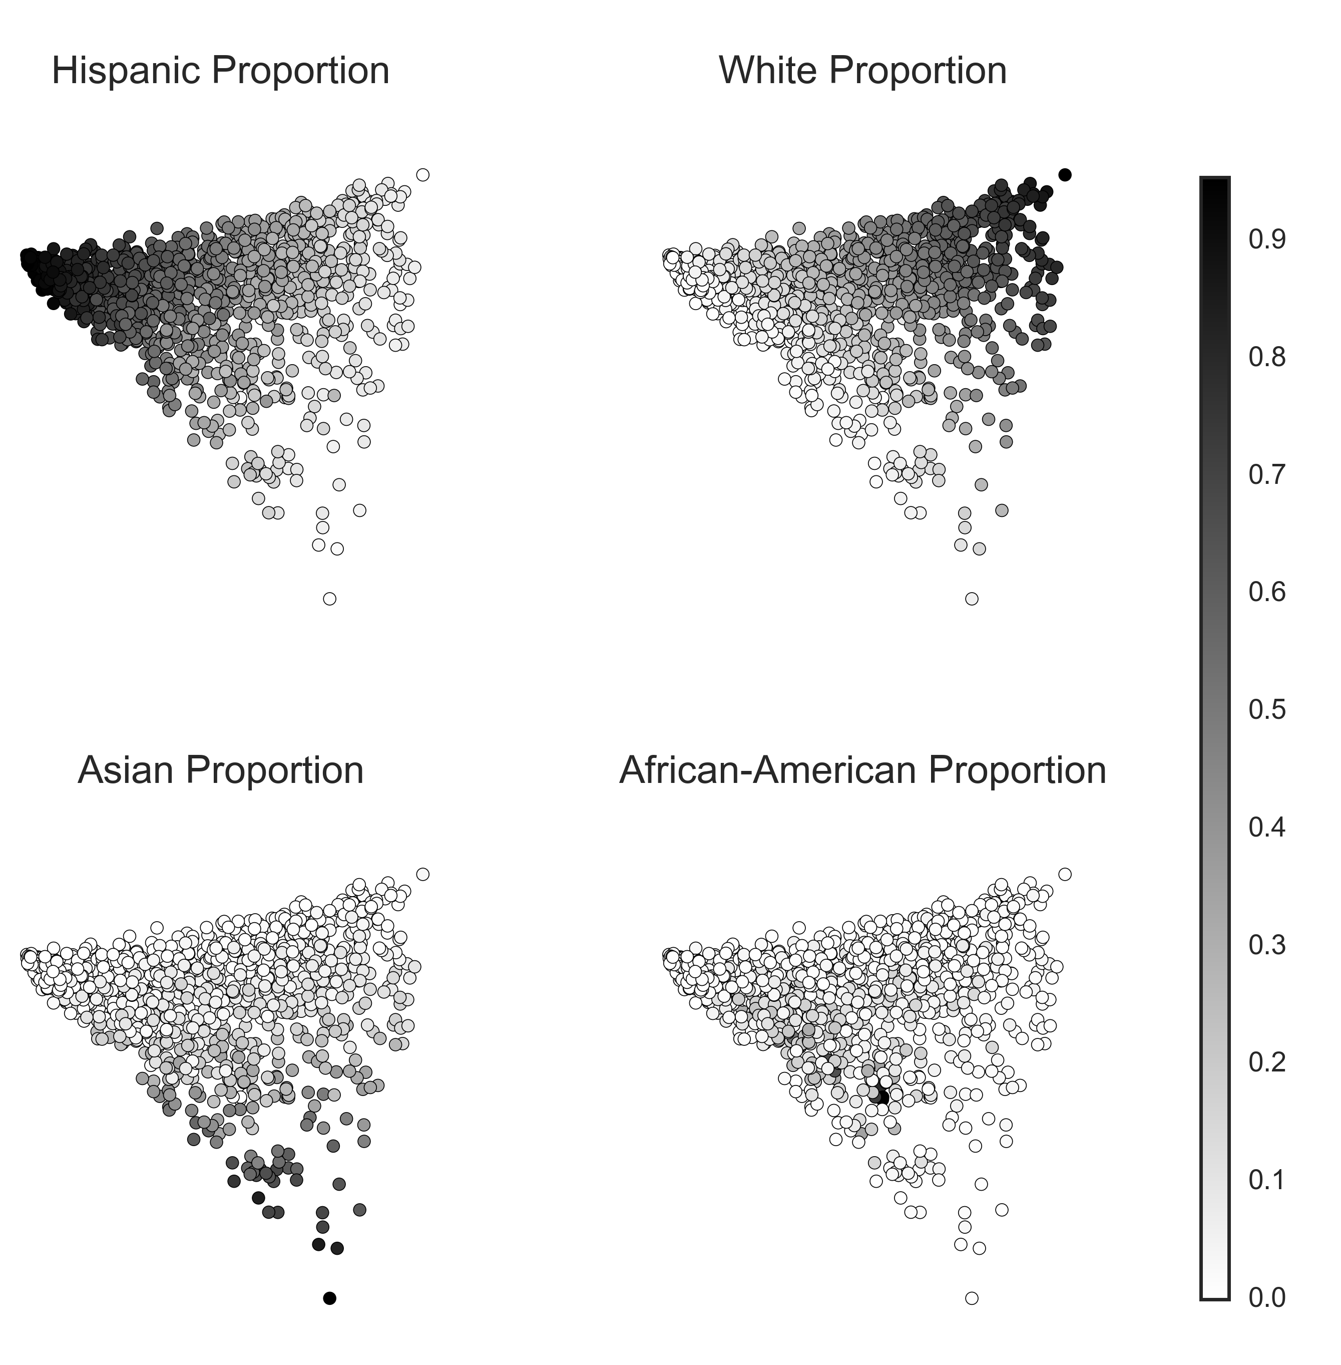
School demographic clusters

Slide 23
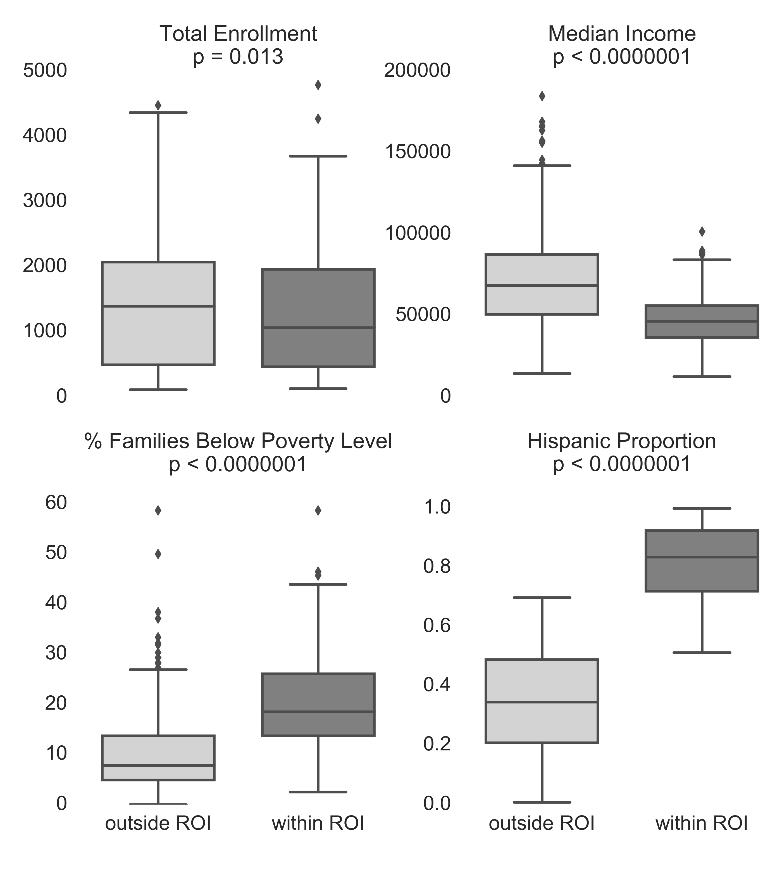
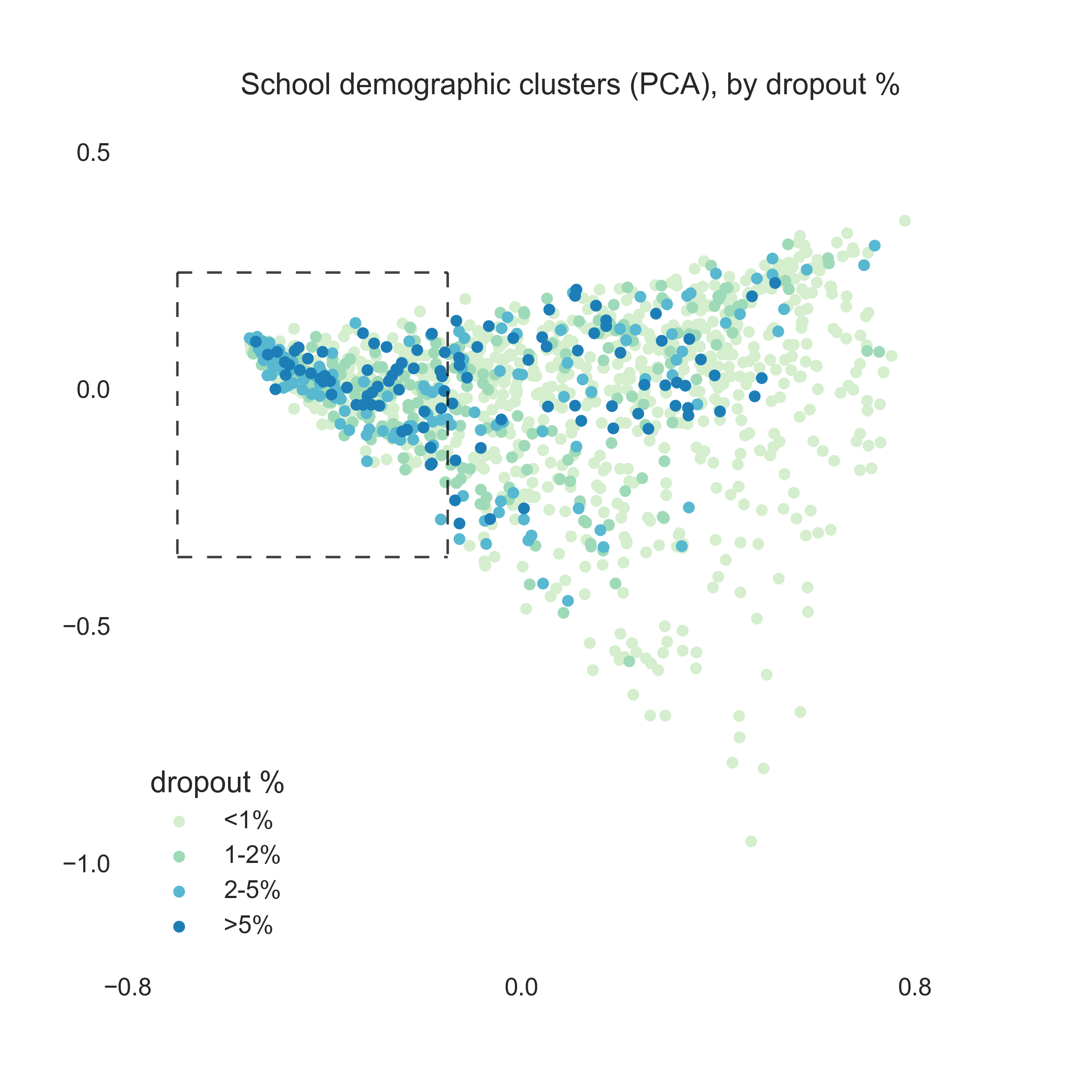
Schools within the ROI have lower median incomes and a higher proportion of Hispanic students

Slide 24
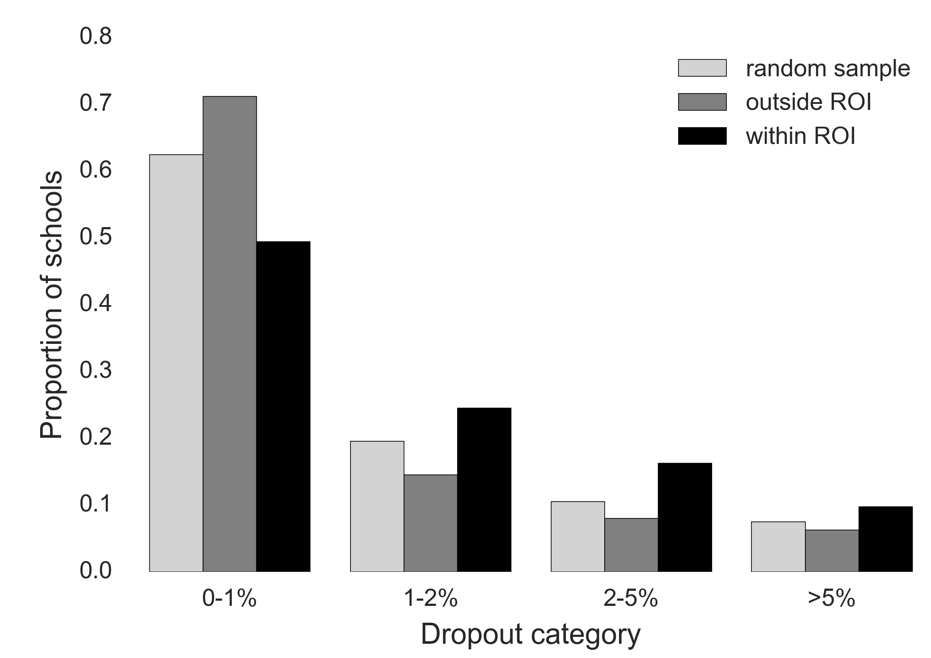
Schools in the region-of-interest (ROI) have a higher percentage of students that dropout
522 schools are within the ROI.
The same number of schools, regardless of ROI location, were randomly sampled.
812 schools are outside the ROI.

Slide 25
Summary of Part Two
Schools with lower median incomes and a higher proportion of Hispanic students showed a higher percentage of dropouts than schools outside this demographic.
Local median incomes are also strongly inversely correlated with the percentage of families with incomes below the poverty line.

Slide 26
Part Three: Low dropout rate schools with demographically-susceptible populations

Slide 27
Key question
What schools have low dropout rates despite demographic susceptibility to dropping out?

Slide 28
Analysis within the ROI
Evaluate schools within the ROI by comparing schools with <1% dropouts (n=258) and >2% dropouts (n=136).
Schools with dropout rates of 1-2% are ignored in this section. (From Part One, the dropout rate across all CA students is 1.5%).

Slide 29
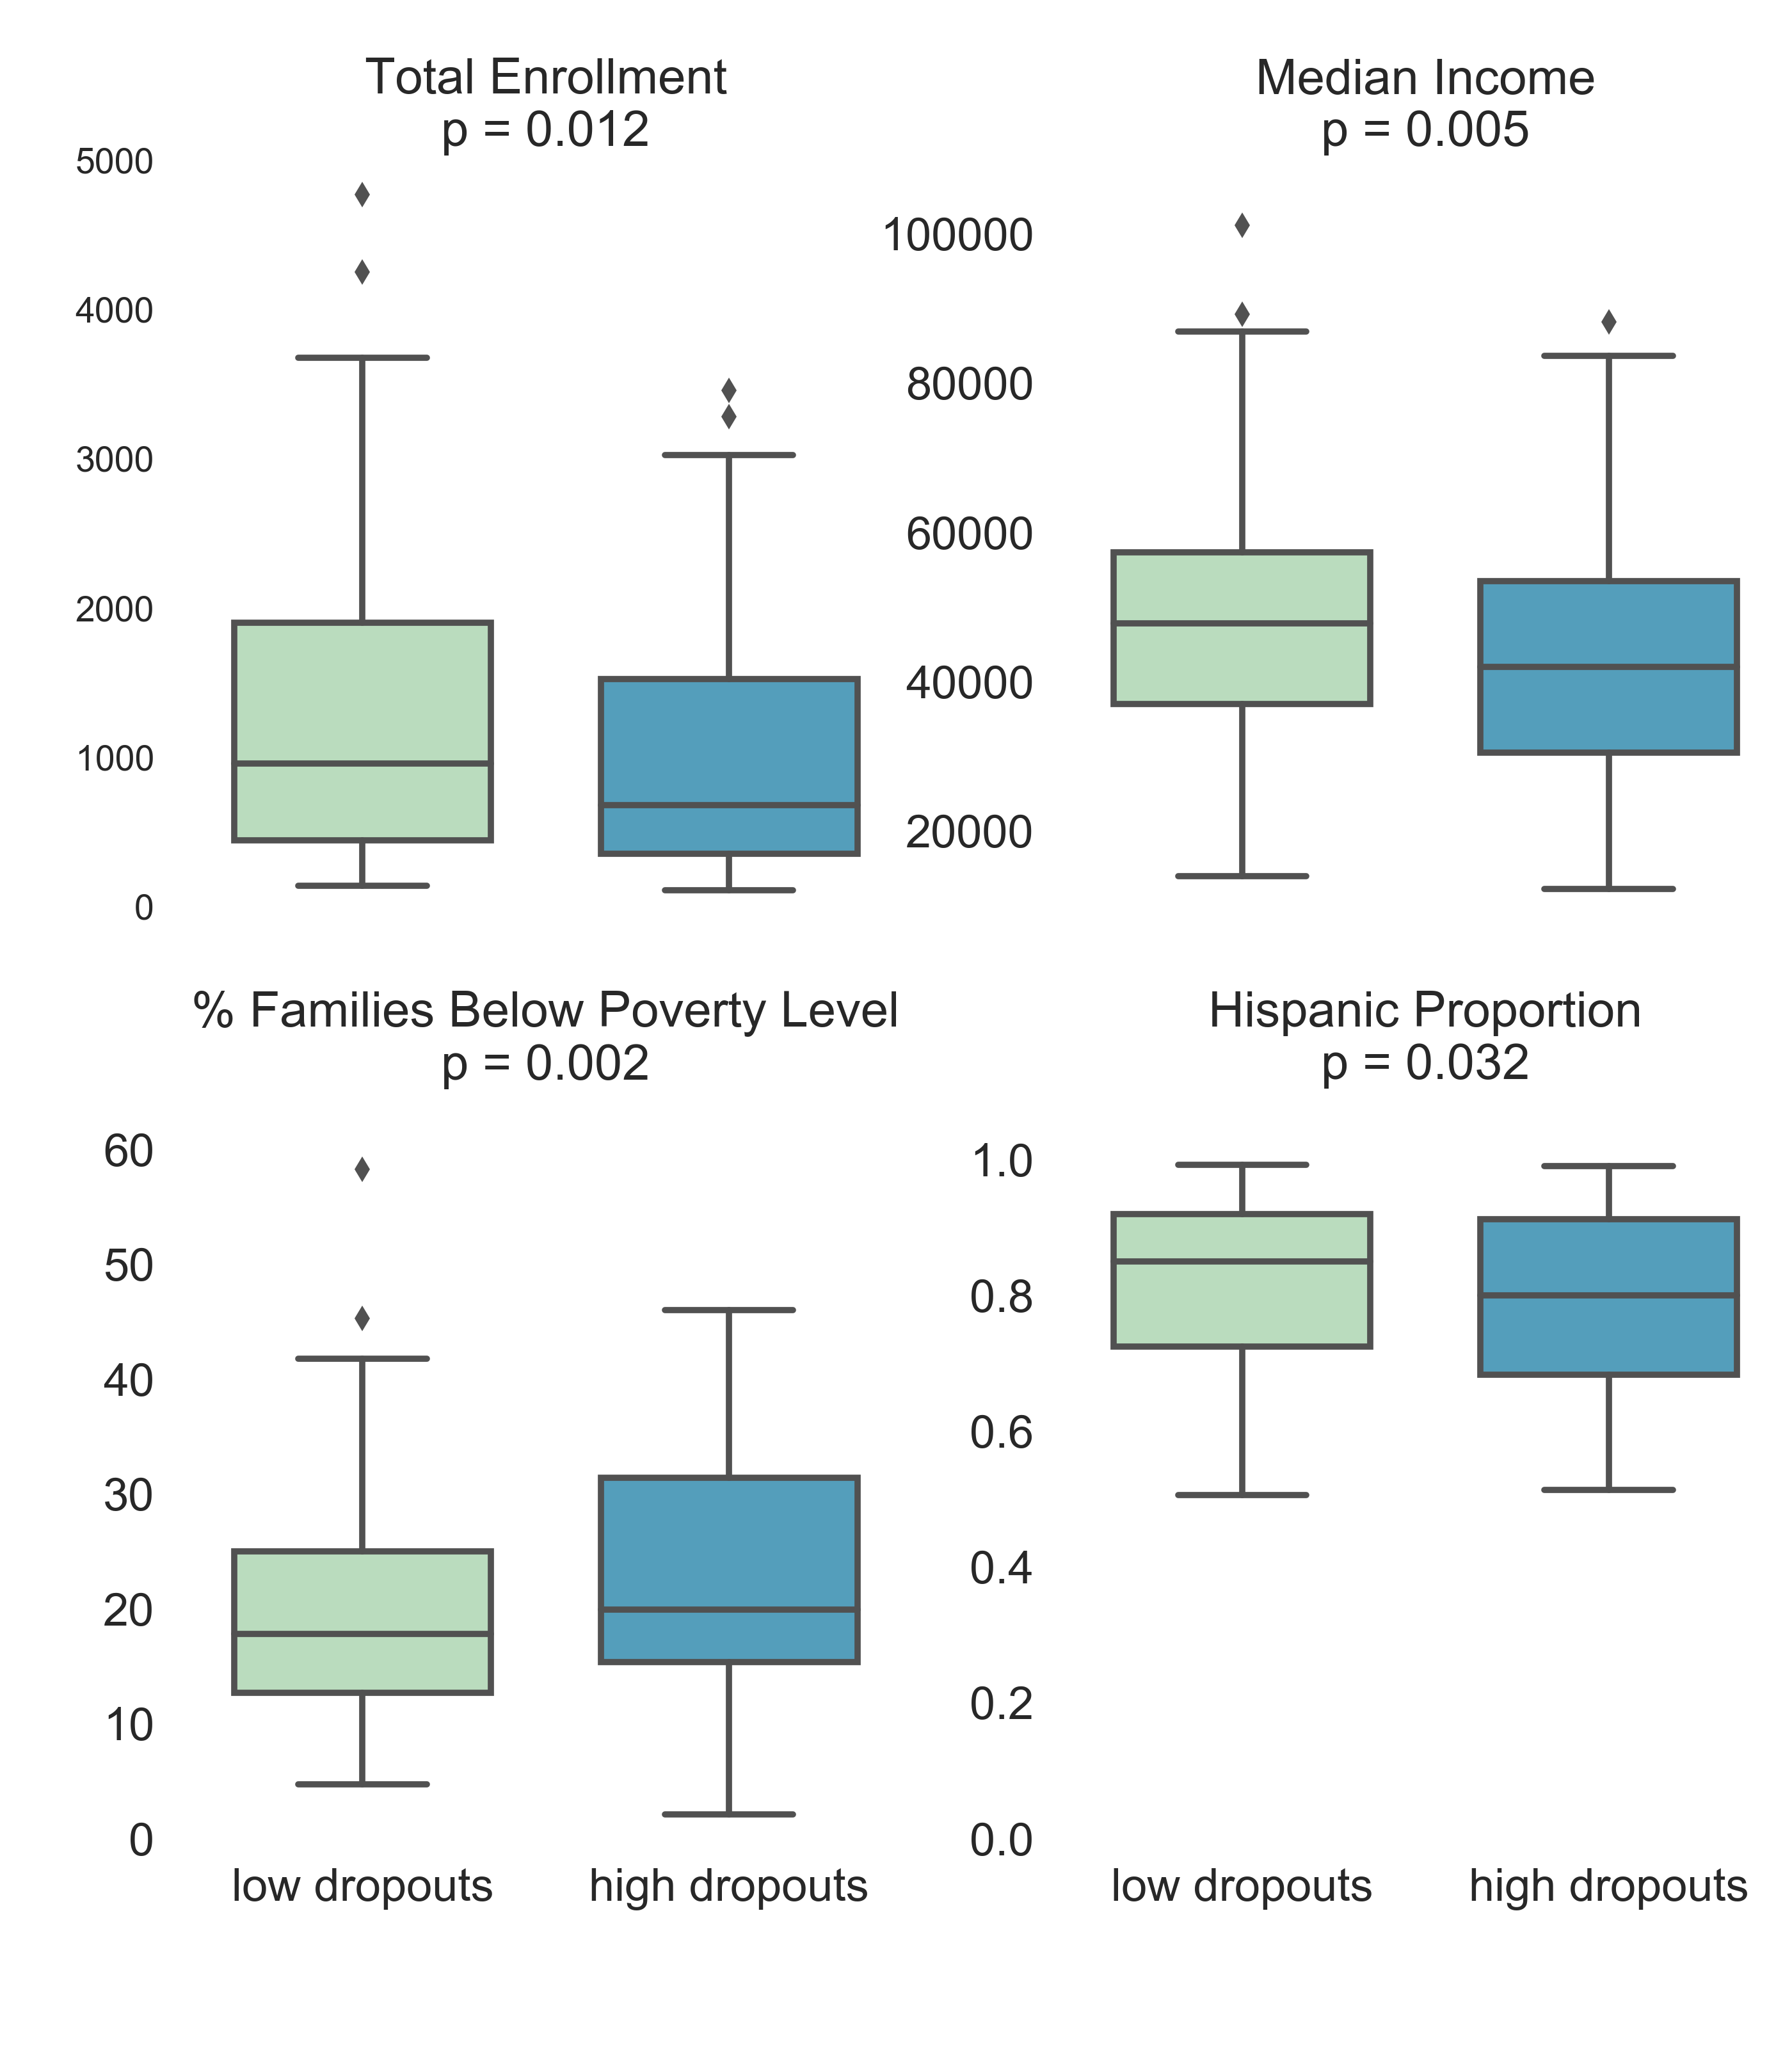
Subtle differences in median income within the ROI

Slide 30
What are the outlier schools in the low dropout group?
Schools with high Hispanic population, low median income, and a high percentage of families below the poverty line tend to be associated with a high dropout rate.
However, some schools with these characteristics have very low dropout rates. What are these schools?

Slide 31
The outlier schools
School | Dropout % | Local Median Income | Hispanic Proportion | White Proportion | Total Enrollment | School Type | City | Zip | District
Stockton Collegiate International Secondary | 0.42 | 14579 | 0.629 | 0.152 | 237 | K-12 Schools (Public) | Stockton | 95202 | Stockton Unified
Orange Cove High | 0.00 | 26800 | 0.983 | 0.010 | 631 | High Schools (Public) | Orange Cove | 93646 | Kings Canyon Joint Unified
Animo Ralph Bunche Charter High | 0.97 | 30251 | 0.990 | 0.002 | 618 | High Schools (Public) | Los Angeles | 90011 | Los Angeles Unified
Synergy Quantum Academy | 0.52 | 30251 | 0.974 | 0.002 | 582 | High Schools (Public) | Los Angeles | 90011 | Los Angeles Unified
Student Empowerment Academy | 0.00 | 30251 | 0.981 | 0.000 | 257 | High Schools (Public) | Los Angeles | 90011 | Los Angeles Unified

Slide 32
Summary of Part Three
Even amongst schools within an ethnic profile (high Hispanic proportion), local median income was still a factor in whether a school had a high dropout rate.
Identification of outlier schools can be a starting point for understanding how to lower the dropout rate in demographically-susceptible populations.

Slide 33
Conclusion

Slide 34
Conclusion
The objective of this project is to identify outlier schools that have low dropout rates despite being demographically at-risk. My hope is that identifying outlier schools could lead to understanding the support mechanisms in these exceptional schools.
While identifying characteristics of the outlier schools in-depth is not within the scope of this project, it is interesting to note that three of the five outlier schools listed received recognition from US News & World Report's list of Best High Schools.

Slide 35
Appendix

Slide 36
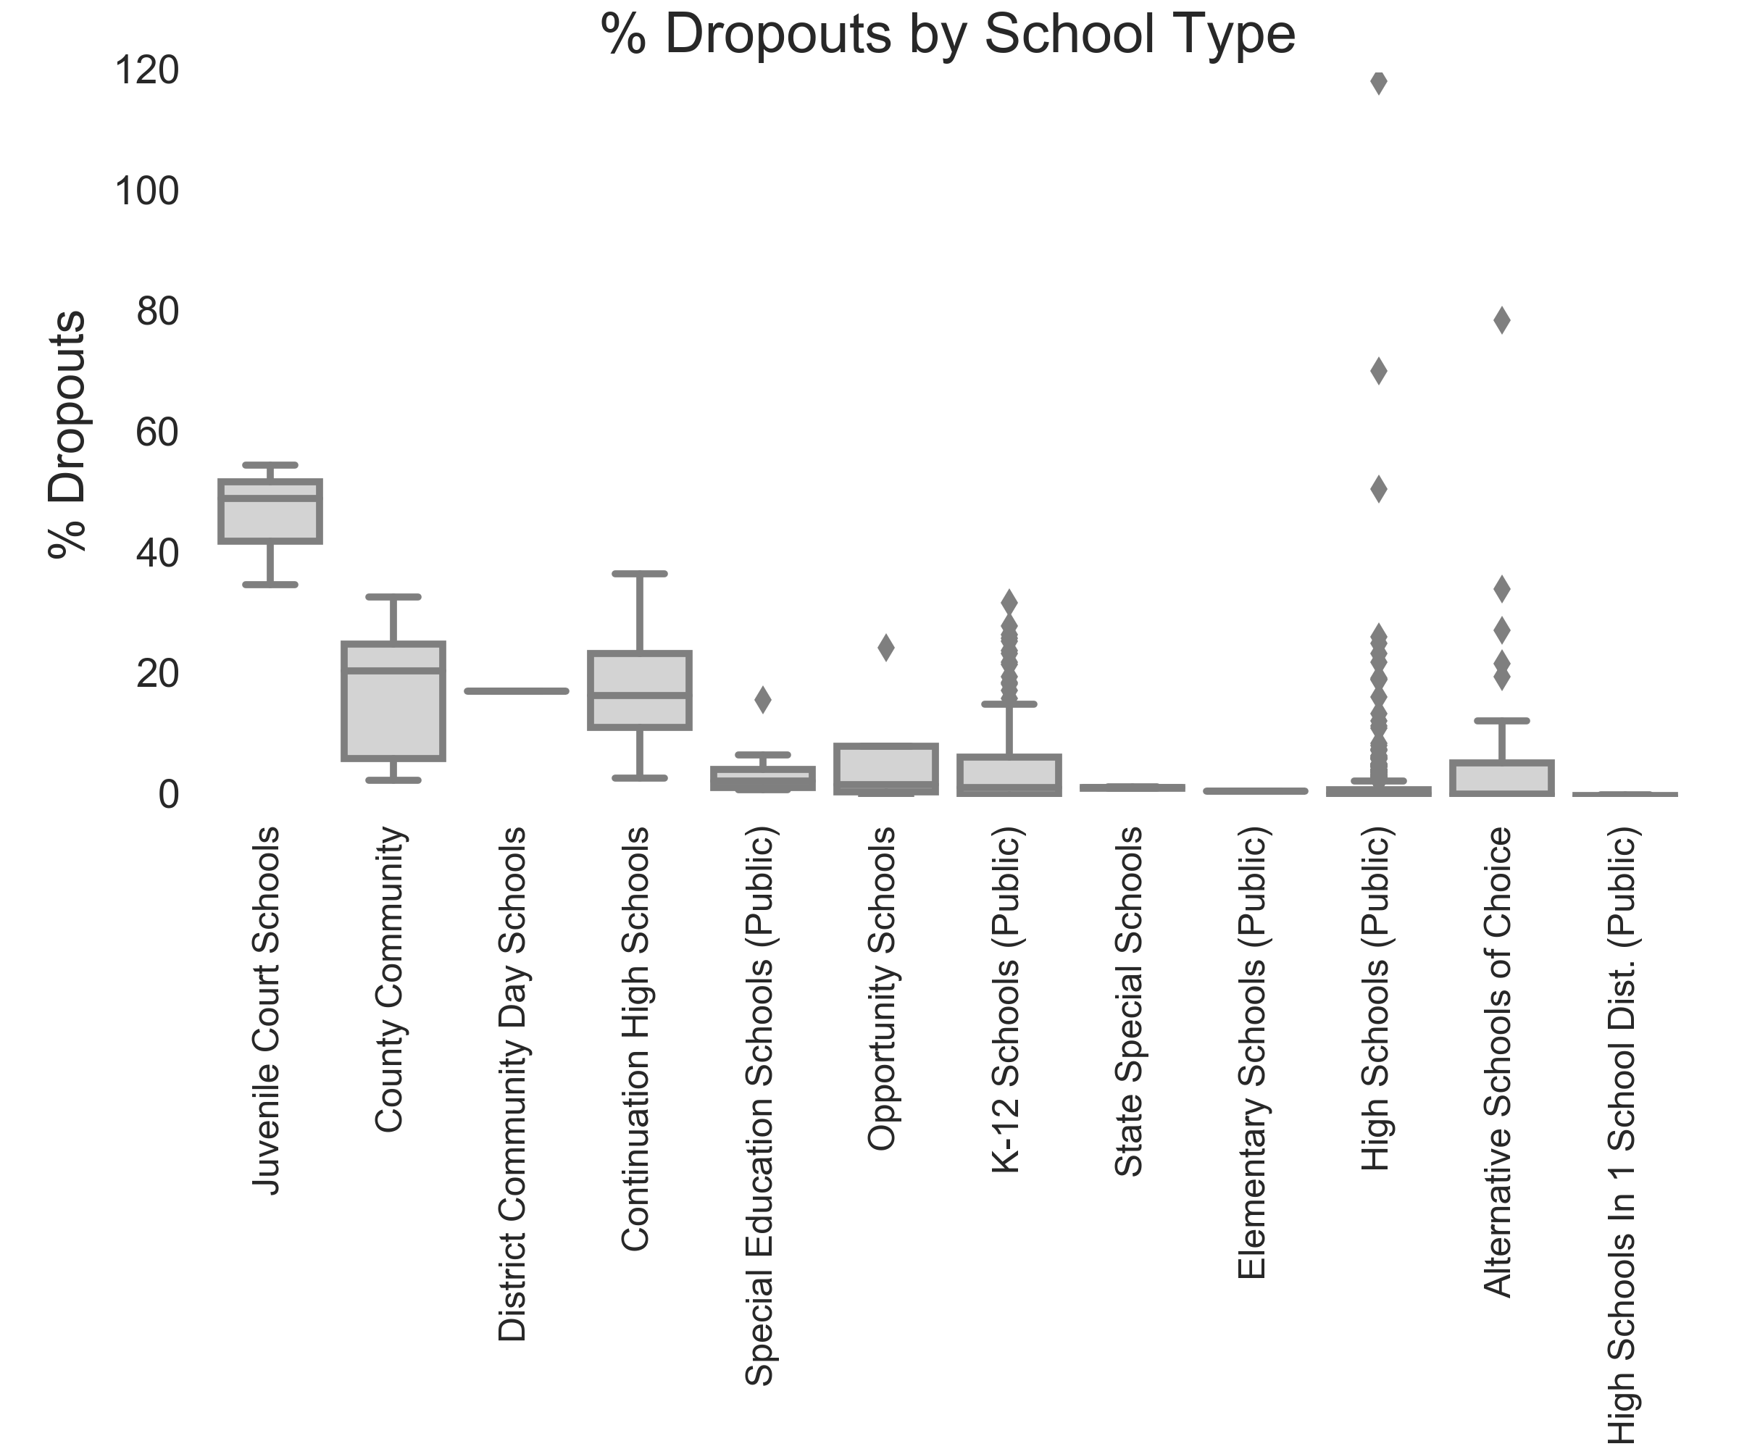
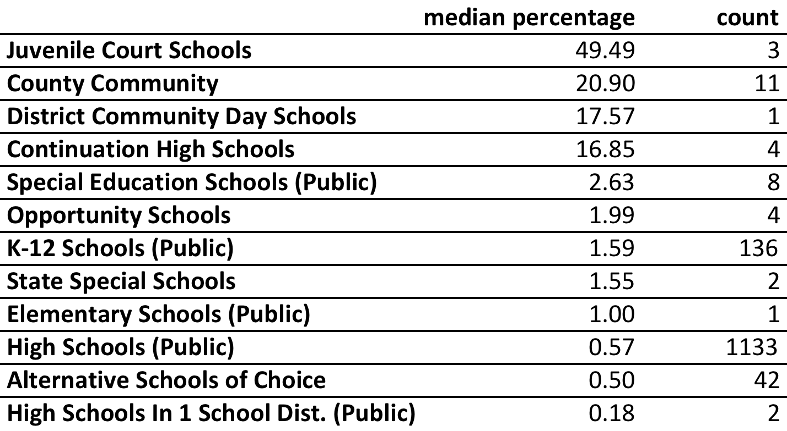
Dropout percentage by school type

Slide 37
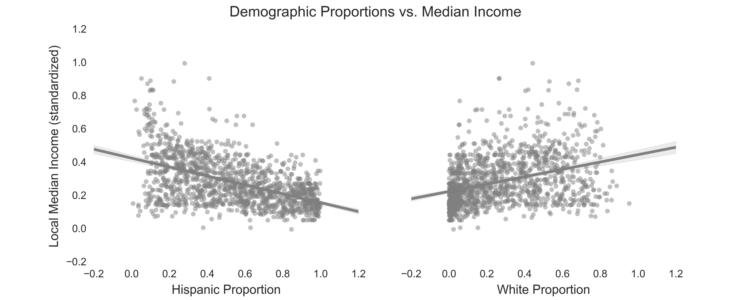
Differential relationship of demographic proportions to median income

Slide 38
Machine learning application

Slide 39
Why apply machine learning?
Practice: As of 12/17/17, I am in the middle of taking Andrew Ng’s Machine Learning course. It is an opportune time to apply some things in practice.

Slide 40
Log of activity

Slide 41
8/19/18 Updating note taking process
After improving my coding and code organization, I’m revisiting this project.
I previously suffered from thinking or expending energy in moving the project forward but without documenting which would facilitate next steps.
This section (“log of activity”) will detail my thought process and provide a list of tangible next steps.

Slide 42
8/19/18 Looked into version controlling
After some research, it seems like version controlling Jupyter notebooks does not seem like an easy process.

Slide 43
8/19/18 Maintaining focus
After some reflection and thinking, carrying out this project is probably the most important thing I can do in taking a step towards being an education data scientist.
My mission is using education to help others come out of situations of economic hardship. I believe data science can play a role in this mission by identifying under-appreciated variables that contribute to success and in identifying the efficacy of educational interventions.
Therefore, being able to show contributions in this domain would make me attractive to organizations with similar missions.
In addition to the dropout and demographic study, I can also look at the project with Tom and other Kaggle projects. In fact, since this project can use better definition, it might make sense to explore Kaggle projects first which have clearer objectives.
This Kaggle competition here seemed similar to what I was looking into. I’m wondering if I can use this to come up with a new angle to my problem.

Slide 44
8/19/18 Maintaining focus
Additional research can help shape questions:
https://www.laweekly.com/news/california-is-home-to-some-of-americas-worst-public-schools-7205447

Slide 45
9/24/19 Using GreatSchools info
I’m using GreatSchools info to get more metrics that have greater variability and detail as opposed to just enrollment and dropout.
For consistency of a set and, slightly for ease in coding, I focused on the “High Schools (Public)” data, which comprises 94% of the enrollment data for CA high school students.

Slide 46
9/24/19 Git log
commit 3aeb96e4be9d533f97be976b00b3754a50f780af (HEAD -> master, origin/master)
Author: benslack19 <ben.lacar@gmail.com>
Date: Tue Sep 24 07:35:24 2019 -0700
added powerpoint to repo; added teacher ratings to dataframe; next: get more detailed-info on low income students
commit dffada543ccc55f3451898d9f386f5b7a99691d3
Author: benslack19 <ben.lacar@gmail.com>
Date: Tue Sep 24 06:37:53 2019 -0700
working on detailed ratings; commit to private github repository; next: work on low income stuff
commit 876029b5c934eb932b7c33add7413ec03f0a878e
Author: benslack19 <ben.lacar@gmail.com>
Date: Mon Sep 23 10:32:06 2019 -0400
faster code for high level ratings; likely limited by internet speed
commit d928d9a6c168ad7880a1d6db7d25f3564abb83b2
Author: benslack19 <ben.lacar@gmail.com>
Date: Thu Sep 19 19:48:03 2019 -0500
increased speed of getting basic ratings; tried linear model; next: add more schools and features to model
commit 404af1ade3d18441c933a8a41f871abdaaa87124
Author: benslack19 <ben.lacar@gmail.com>
Date: Wed Sep 18 22:12:30 2019 -0700
added high level ratings, next: make it go faster
commit d709da551a043cfb2951a589f709dbd641075715
Author: benslack19 <ben.lacar@gmail.com>
Date: Wed Sep 18 21:07:20 2019 -0700
initial commit

Slide 47
9/26/19 git branch
Made a git branch, “testing4speed” where I tested LA unified schools

Slide 48
9/26/19 NewDoor Glowup awards
Attended the event with Greg, it gave me some perspective. A couple of students attended this school but there are no metrics.
https://www.greatschools.org/california/oakland/200-Dewey-Academy/

Slide 49
9/29/19 Scaling features
Made some ML functions
Make sure features chosen make sense
Independent
Normalized
https://towardsdatascience.com/graphs-and-ml-multiple-linear-regression-c6920a1f2e70

Slide 50
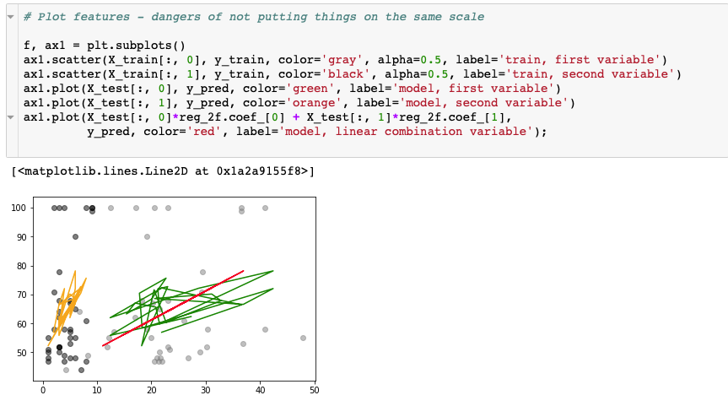
9/29/19 Scaling features
Dangers of not putting things on the same scale. The first variable (green) has bigger values than the second variable (orange) so it dominates the model (red).

Slide 51
10/1/19 code cleanup
Did a lot of cleanup, removing previous things I tried (lots of stuff) to make it closer to “presentation“ mode.
Mainly removed stuff when I evaluated dropout rate as something to predict.

Slide 52
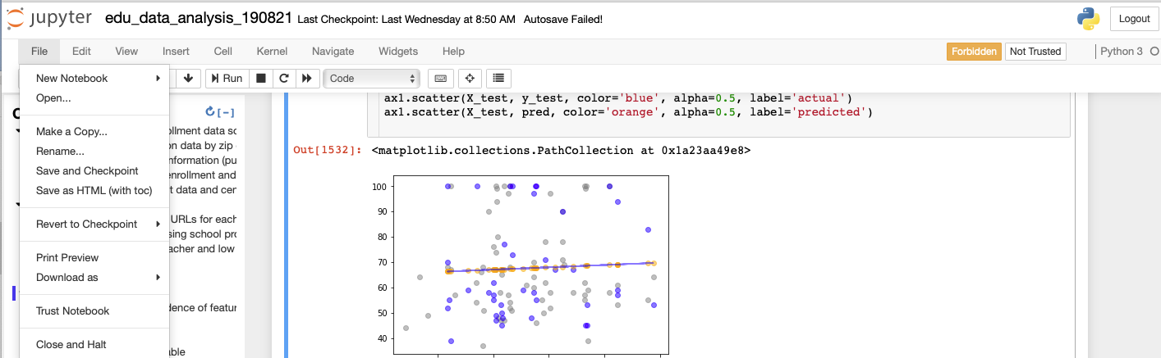
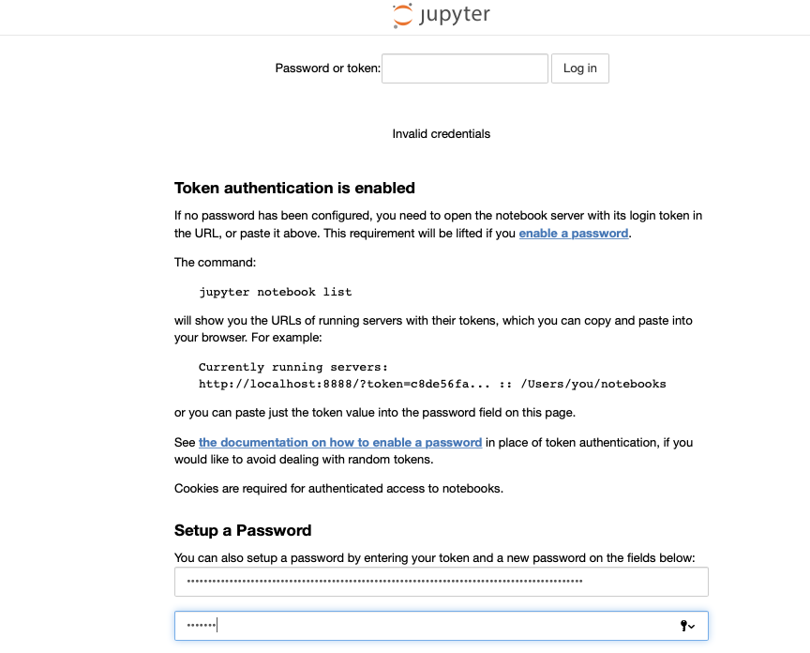
10/5/19 token and password for jupyter notebook?
This is the first time I had seen something like this. I couldn‘t save or download the notebook, but from my git it seemed to recognize the changes.
I‘ll use the token and use my mac login pw – didn‘t work.

Slide 53
10/5/19 token and password for jupyter notebook?
The saving issue seemed to resolve itself so I‘m sticking with the 8/21 notebook

Slide 54
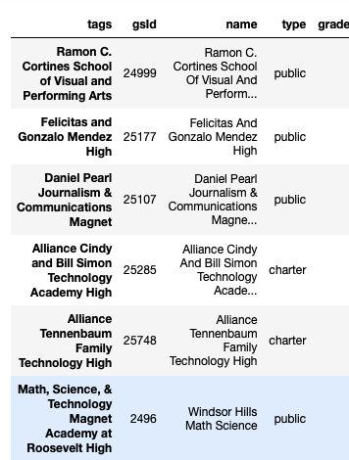
10/6/19 bug to resolve later
Note how last school doesn‘t match.
I‘ll just ignore for now with try/except

Slide 55
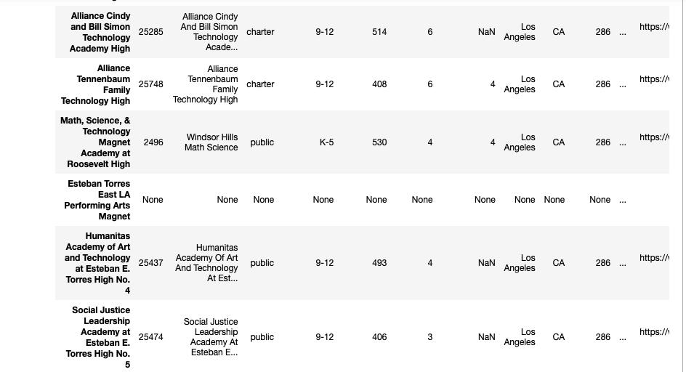
10/6/19 bug to resolve later
Esteban Torres shouldn‘t have any HL ratings

Slide 56
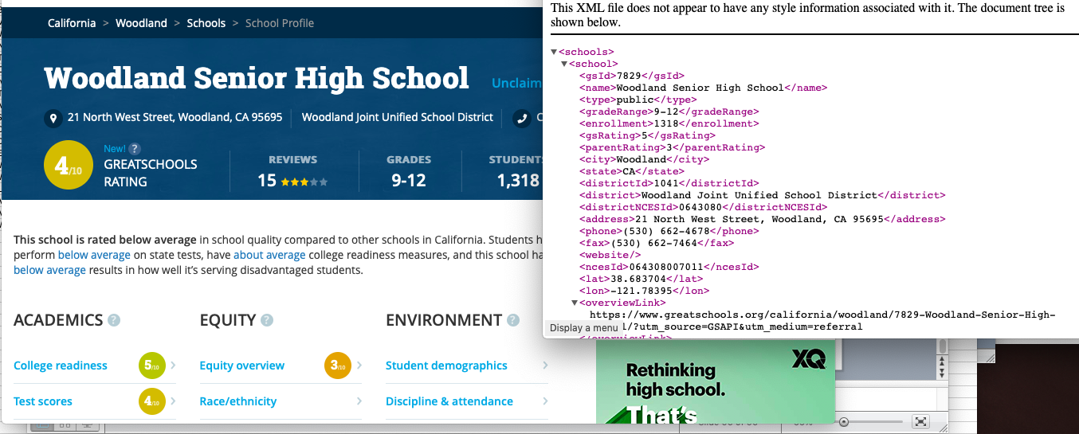
10/6/19 GS bug: website rating doesn’t match what’s on API

